Slide 1
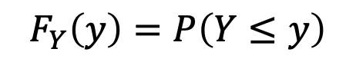
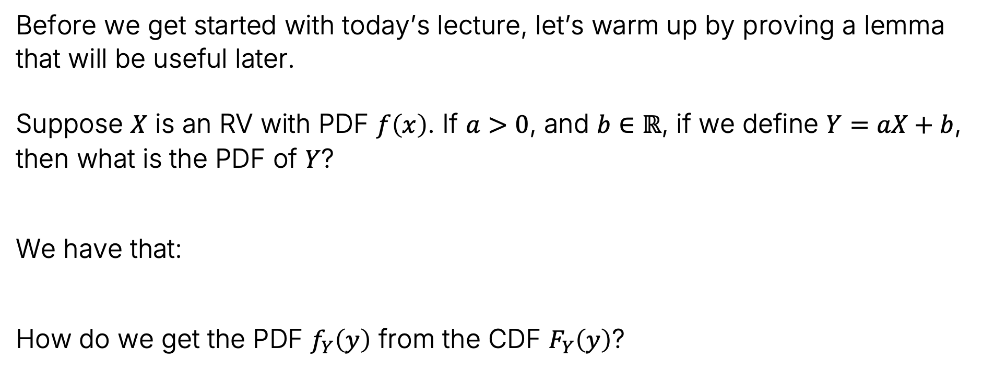
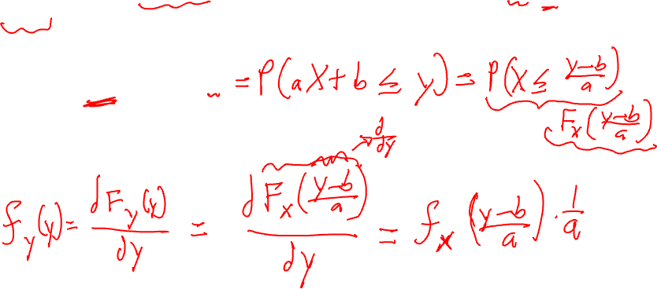
Warmup Exercise / Detour: Prove this Lemma
Before we get started with today’s lecture, let’s warm up by proving a lemma that will be useful later.
Suppose $X$ is an RV with PDF $f\left(x\right)$. If $a>0$, and $b∈ℝ$, if we define $Y=aX+b$, then what is the PDF of $Y$?
We have that:
How do we get the PDF $f_{Y}\left(y\right)$ from the CDF $F_{Y}\left(y\right)$?
$$F_{Y}\left(y\right)=P\left(Y≤y\right)$$

Slide 2




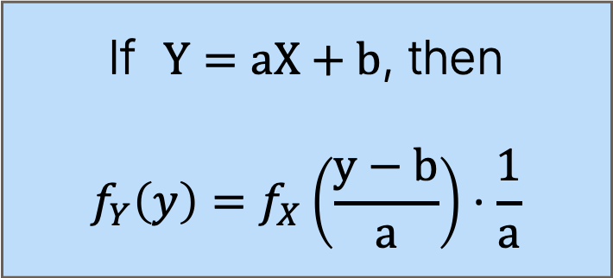


Warmup Exercise / Detour: Prove this Lemma
Before we get started with today’s lecture, let’s warm up by proving a lemma that will be useful later.
Suppose $X$ is an RV with PDF $f\left(x\right)$. If $a>0$, and $b∈ℝ$, if we define $Y=aX+b$, then what is the PDF of $Y$?
We have that:
How do we get the PDF $f_{Y}\left(y\right)$ from the CDF $F_{Y}\left(y\right)$?
$$=P\left(X≤\frac{y−b}{a}\right)$$
$$=F_{X}\left(\frac{y−b}{a}\right)$$
$$F_{Y}\left(y\right)=P\left(Y≤y\right)$$
$$=P\left(aX+b≤y\right)$$
If $Y=aX+b$, then
$$f_{Y}\left(y\right)=f_{X}\left(\frac{y−b}{a}\right)⋅\frac{1}{a}$$
$$=\frac{dF_{X}\left(\frac{y−b}{a}\right)}{dy}$$
$$f_{Y}\left(y\right)=\frac{dF_{Y}\left(y\right)}{dy}$$
$$=f_{X}\left(\frac{y−b}{a}\right)⋅\frac{1}{a}$$

Slide 3
Data Colada
Data Colada “is a blog dedicated to investigative analysis and replication of academic research, focusing in particular on the validity of findings in the social sciences.”
The blog is run by Uri Simonsohn at ESADE Business School in Barcelona, Leif Nelson at Haas here at Berkeley, and Joseph Simmons at the Wharton School at Penn.
Their work has found evidence of serious academic misconduct, even among world class researchers at universities like Harvard and Duke. See this video.
Today, we’ll get a glimpse into one of the mathematical techniques that make it possible to sniff out this type of fraud.

Slide 4
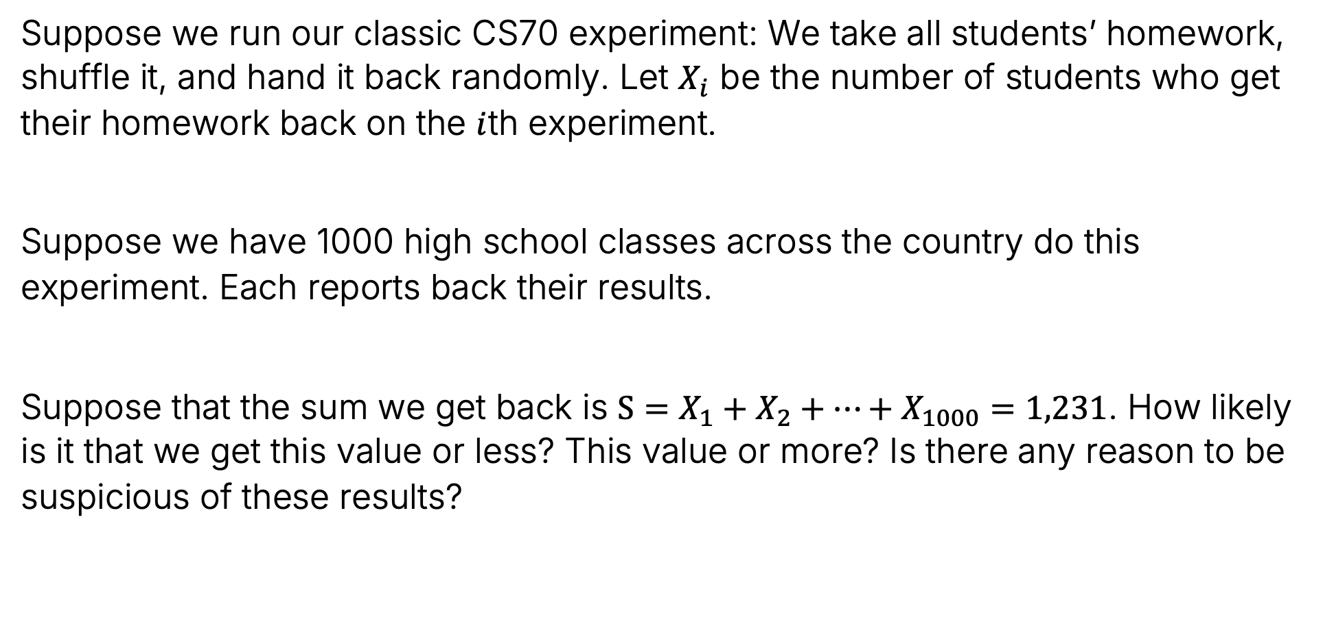

Example Claim to Evaluate
Suppose we run our classic CS70 experiment: We take all students’ homework, shuffle it, and hand it back randomly. Let $X_{i}$ be the number of students who get their homework back on the $i$th experiment.
Suppose we have 1000 high school classes across the country do this experiment. Each reports back their results.
Suppose that the sum we get back is $S=X_{1}+X_{2}+…+X_{1000}=1,231$. How likely is it that we get this value or less? This value or more? Is there any reason to be suspicious of these results?

Slide 5
Empirical Observation
Lecture 24, CS70 Fall 2025

Slide 6
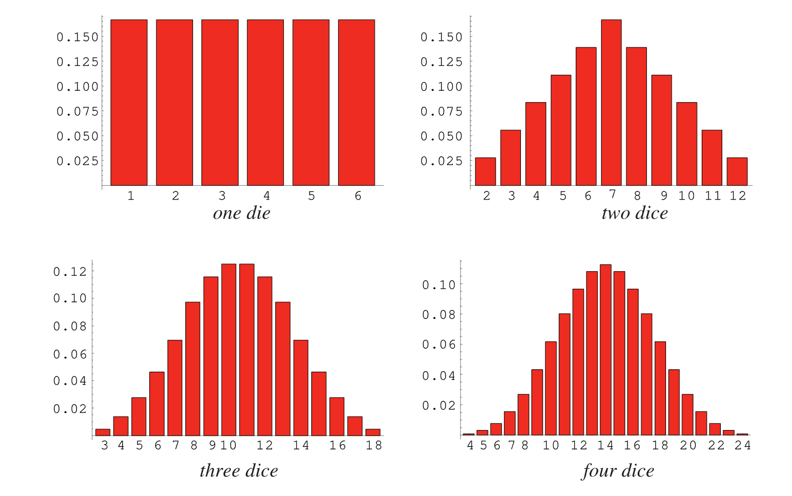



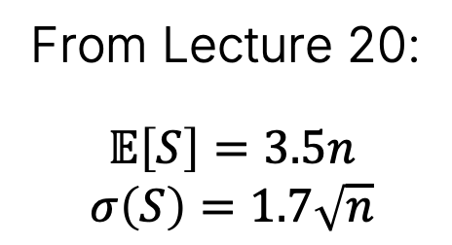
From https://mathworld.wolfram.com/Dice.html
From Lecture 20:
$$𝔼\left[S\right]=3.5n$$
$$σ\left(S\right)=1.7\sqrt{n}$$
$$𝔼\left[S\right]=14$$
Note: The operation that is happening here is called “convolution”. We won’t discuss today.
$$σ\left(S\right)=3.4$$

Slide 7
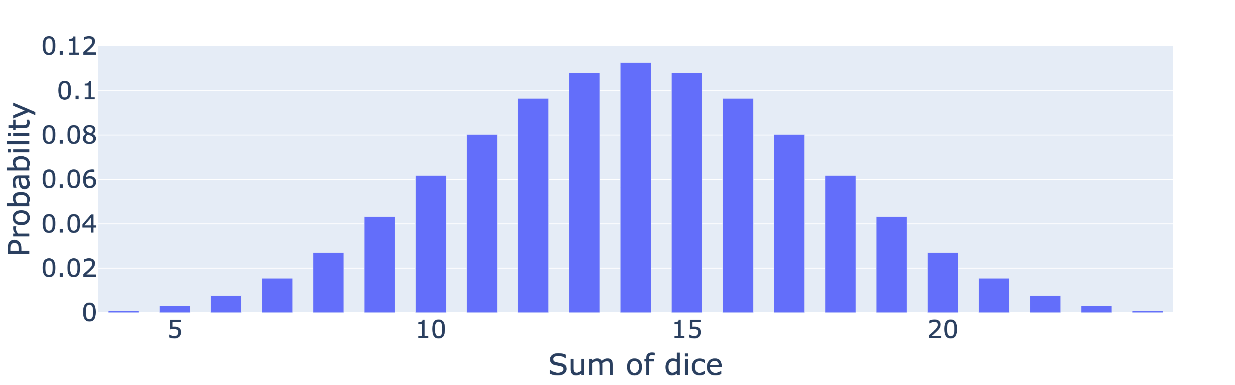

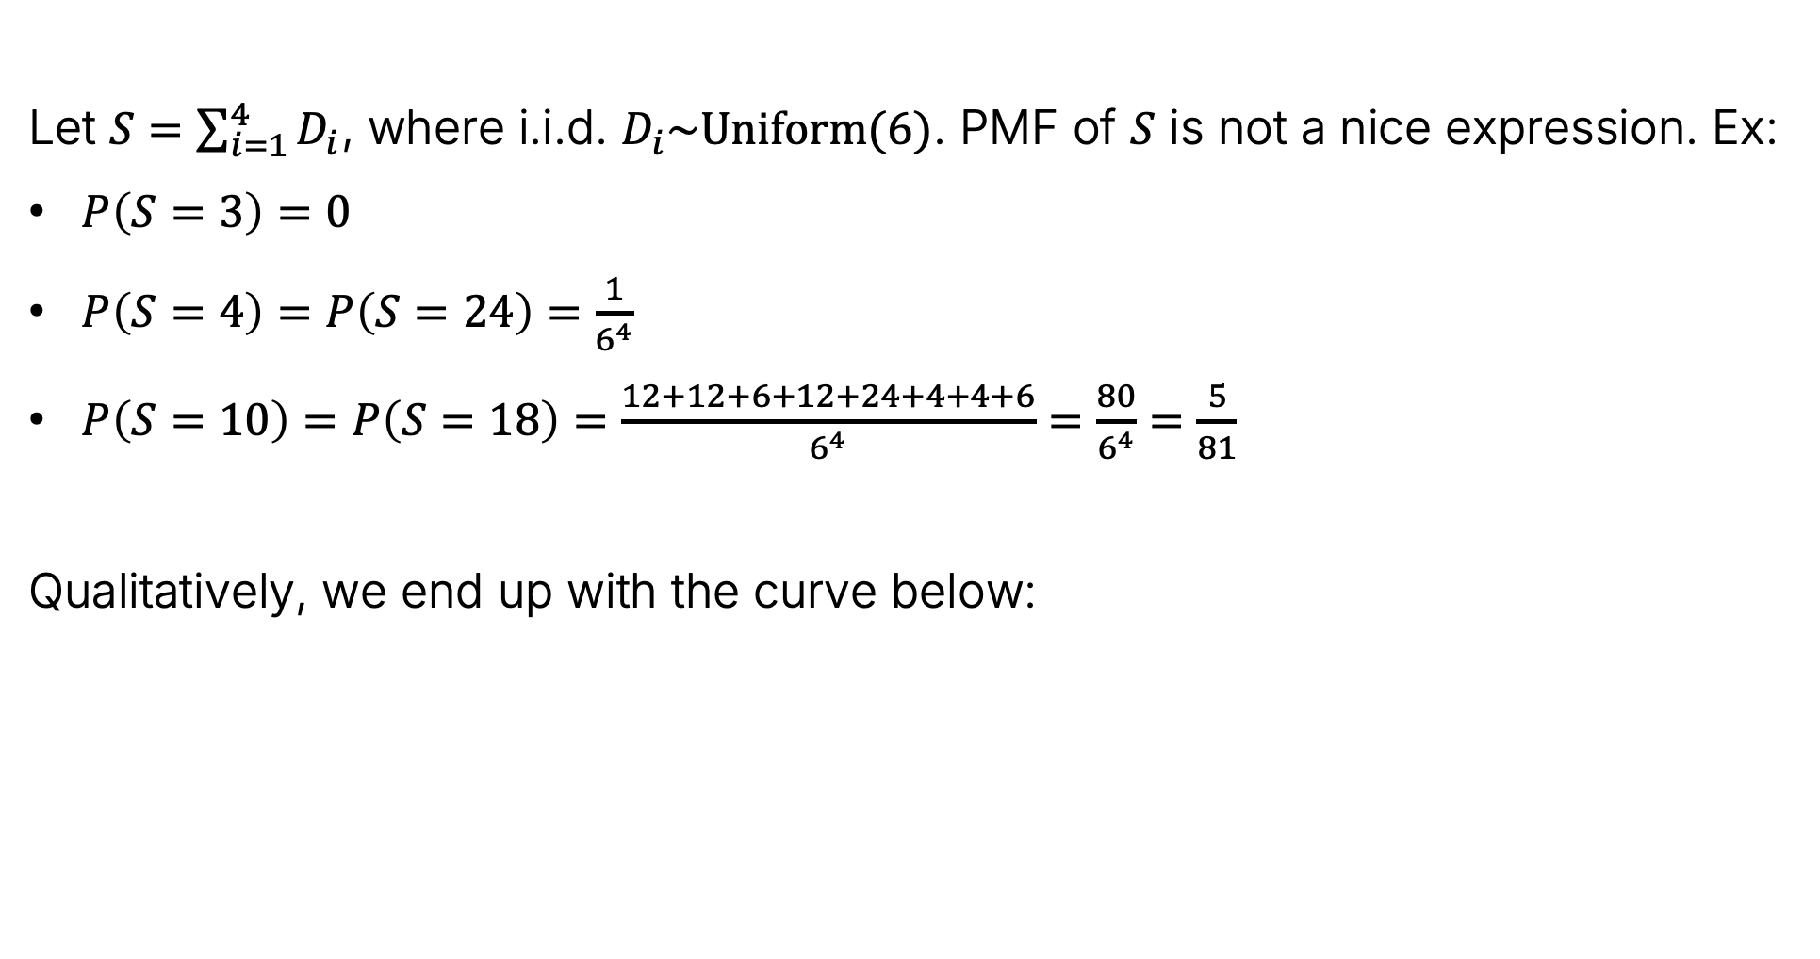


Example 1: DiceSum for n = 4 six sided dice
Let $S=\sum_{i=1}^{4}{D_{i}}$, where i.i.d. $D_{i}\sim Uniform(6)$. PMF of $S$ is not a nice expression. Ex:
$P\left(S=3\right)=0$
$P\left(S=4\right)=P\left(S=24\right)=\frac{1}{6^{4}}$
$P\left(S=10\right)=P\left(S=18\right)=\frac{12+12+6+12+24+4+4+6}{6^{4}}=\frac{80}{6^{4}}=\frac{5}{81}$
Qualitatively, we end up with the curve below:
$$𝔼\left[S\right]=14$$
$$σ\left(S\right)=3.4$$

Slide 8
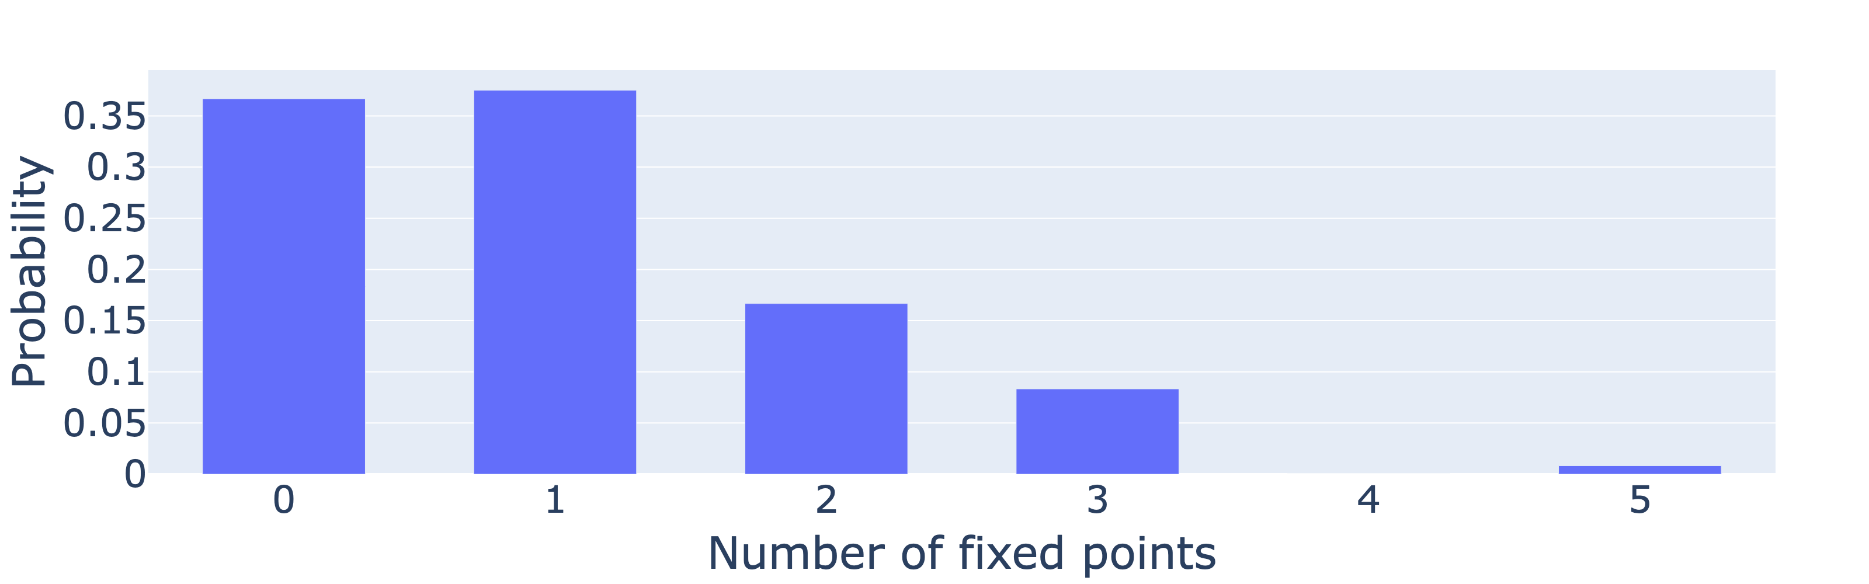
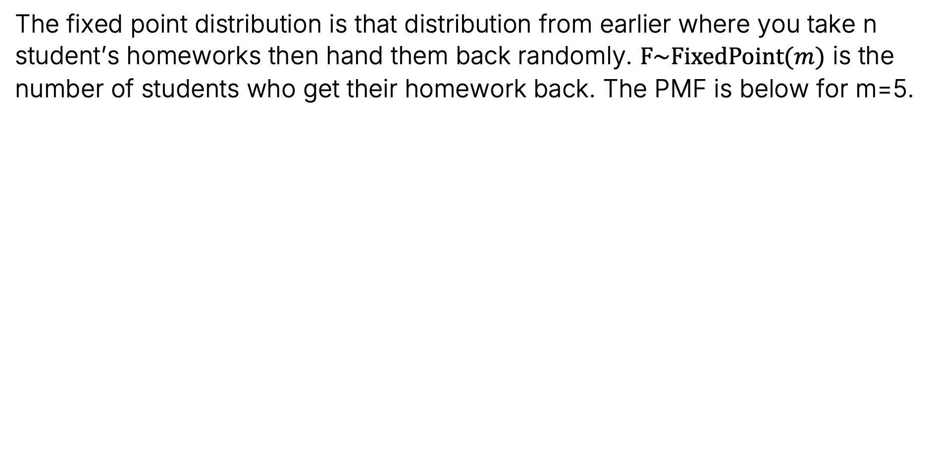

Example 2: The Fixed Point Distribution
The fixed point distribution is that distribution from earlier where you take n student’s homeworks then hand them back randomly. $F\sim FixedPoint(m)$ is the number of students who get their homework back. The PMF is below for m=5.

Slide 9
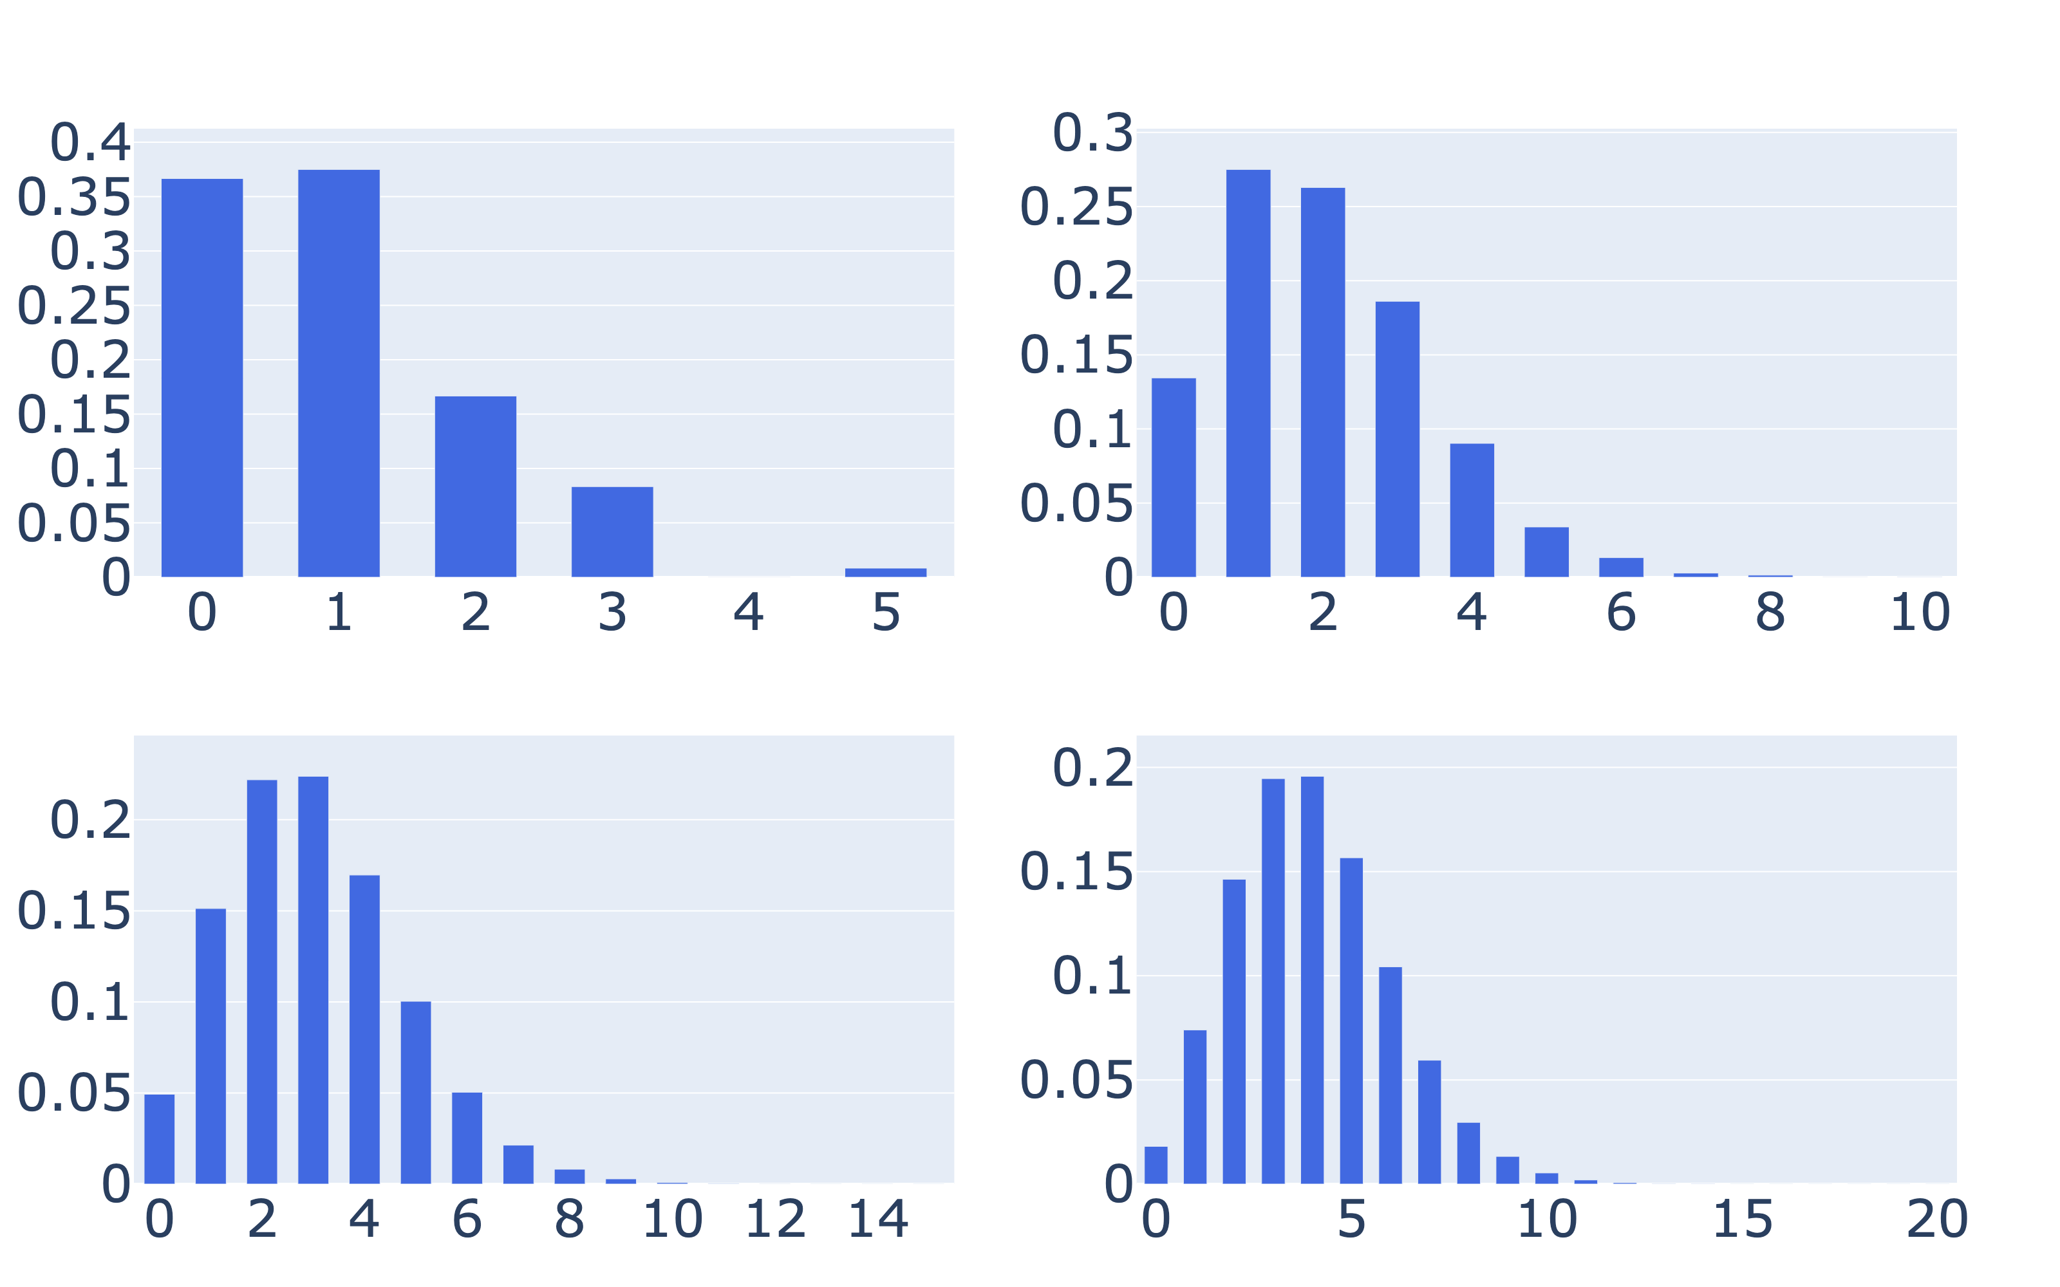
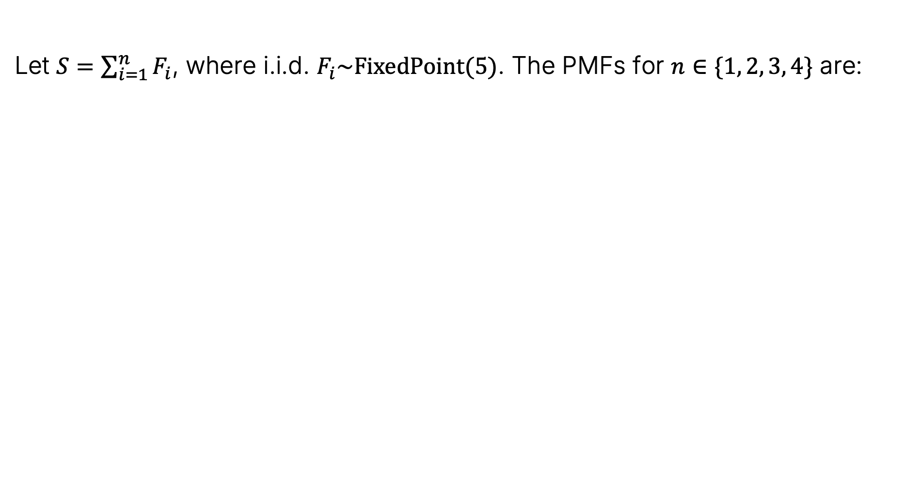
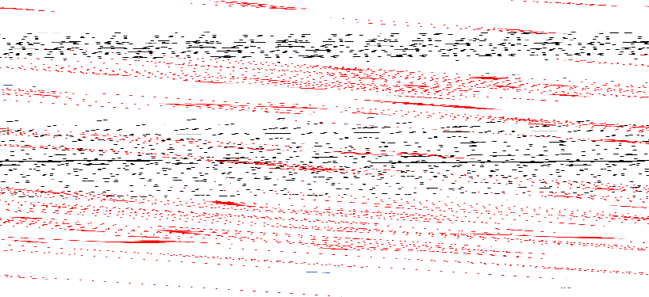
Example 2: The Fixed Point Distribution
Let $S=\sum_{i=1}^{n}{F_{i}}$, where i.i.d. $F_{i}\sim FixedPoint(5)$. The PMFs for $n∈\{1, 2, 3, 4\}$ are:

Slide 10
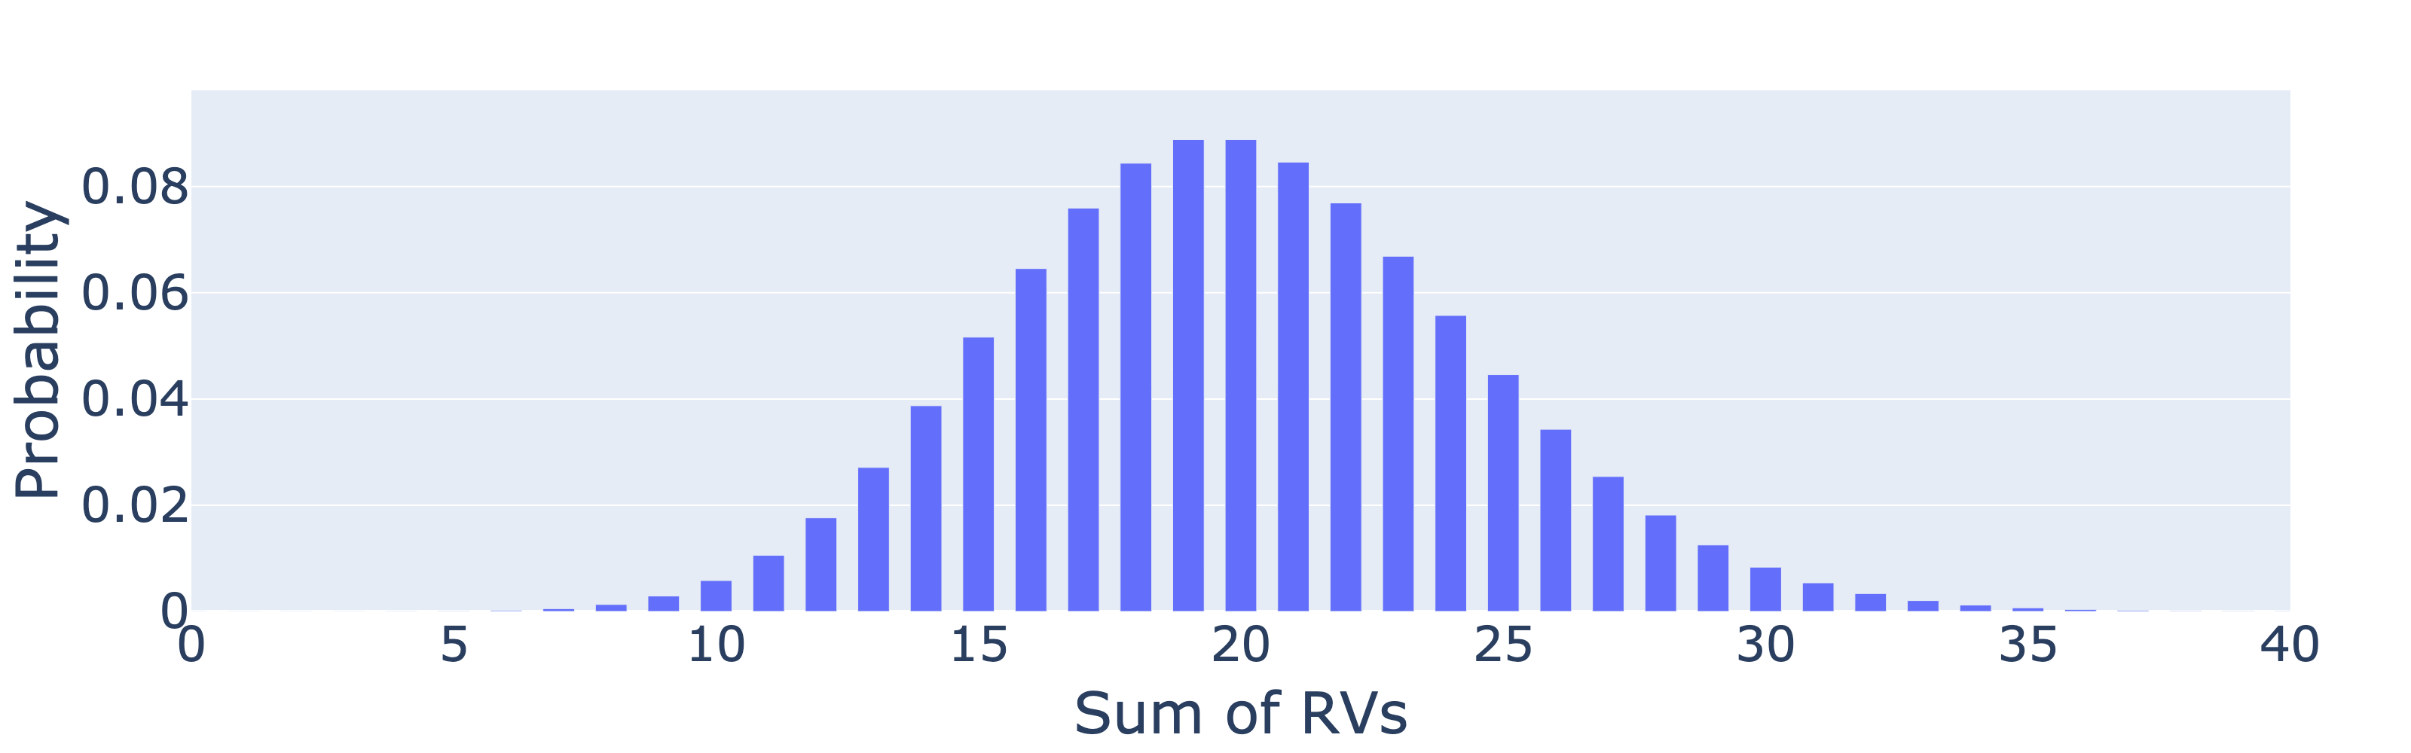


Sums of Dice vs. Fixed Points
Below, we see the result of summing 20 fixed point random variables.
Qualitatively very similar to what we get from summing dice.
In fact, one can show that they converge in the large n limit to a continuous distribution called the Gaussian distribution.
We’ll return to how we can use the Gaussian approximation at the end of lecture.
$$∑$$

Slide 11
Gaussian Distribution
Lecture 24, CS70 Fall 2025

Slide 12
The Gaussian Distribution
The Gaussian distribution is the most famous continuous distribution.
Arises naturally in many theoretical contexts.
Useful for modeling real world phenomena.
Has very convenient mathematical properties.

Slide 13
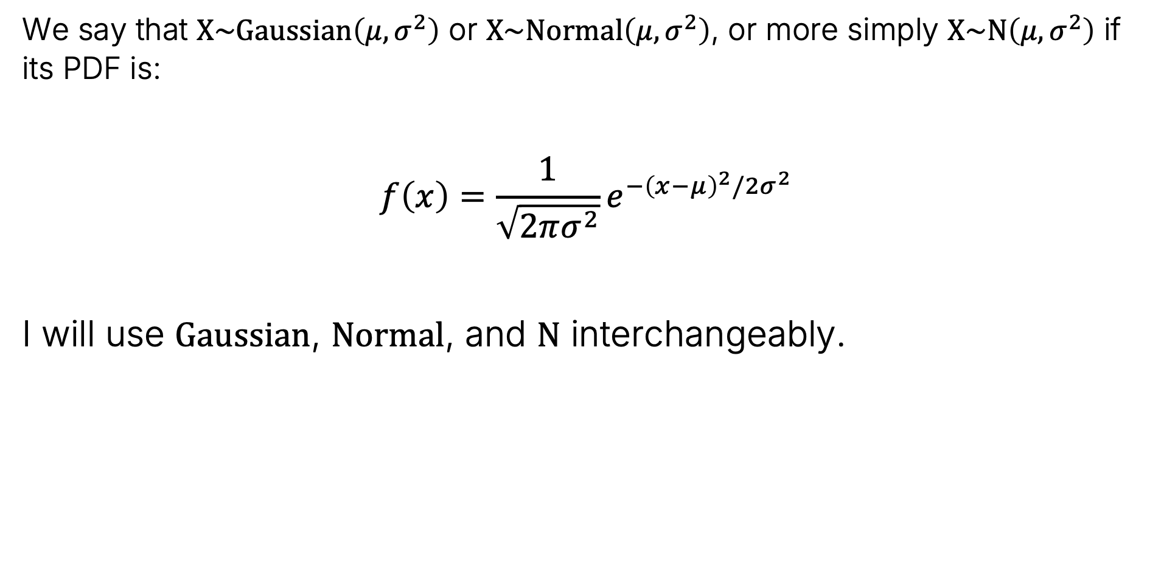

Normal (Gaussian) Distribution
We say that $X\sim Gaussian\left(μ, σ^{2}\right)$ or $X\sim Normal\left(μ, σ^{2}\right)$, or more simply $X\sim N\left(μ, σ^{2}\right)$ if its PDF is:
$$f\left(x\right)=\frac{1}{\sqrt{2πσ^{2}}}e^{{−\left(x−μ\right)}^{2}/2σ^{2}}$$
I will use $Gaussian$, $Normal$, and $N$ interchangeably.

Slide 14
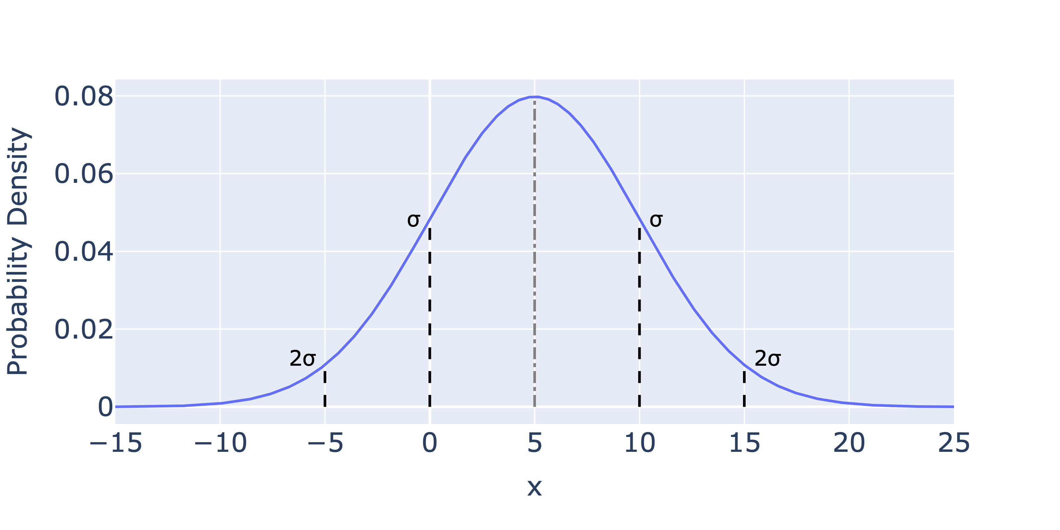
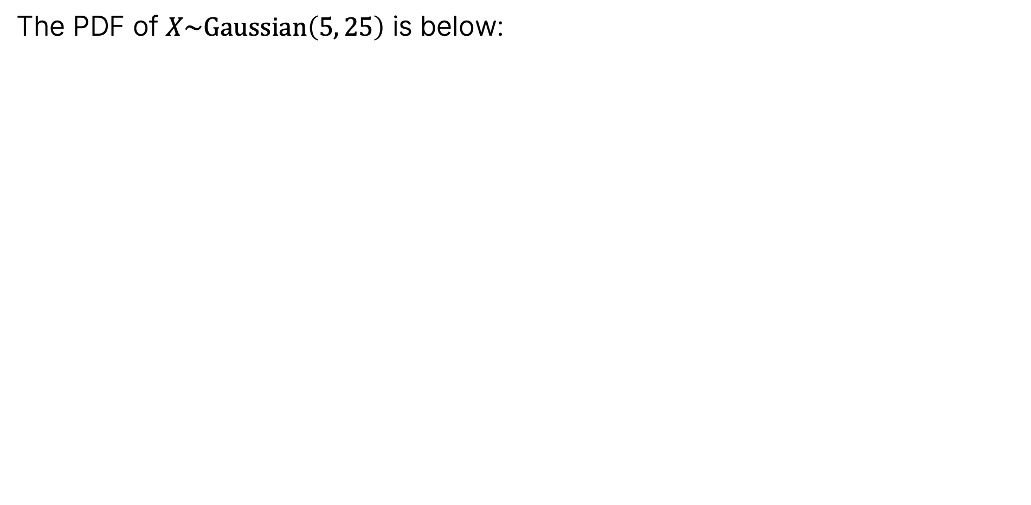
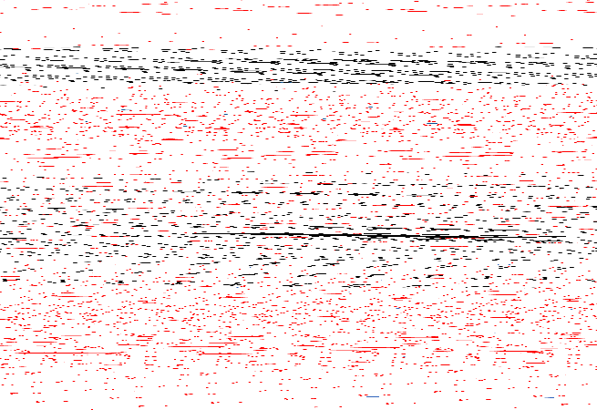

The Gaussian PDF Visually
The PDF of $X\sim Gaussian\left(5, 25\right)$ is below:
$$f\left(x\right)=\frac{1}{\sqrt{2π25}}e^{\frac{{−\left(x−5\right)}^{2}}{2}2×25}$$

Slide 15
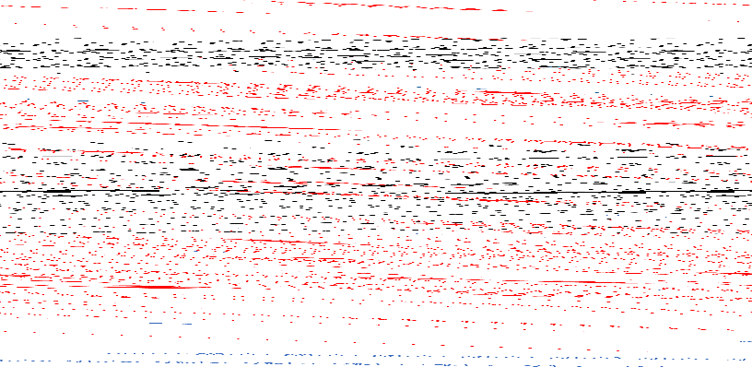
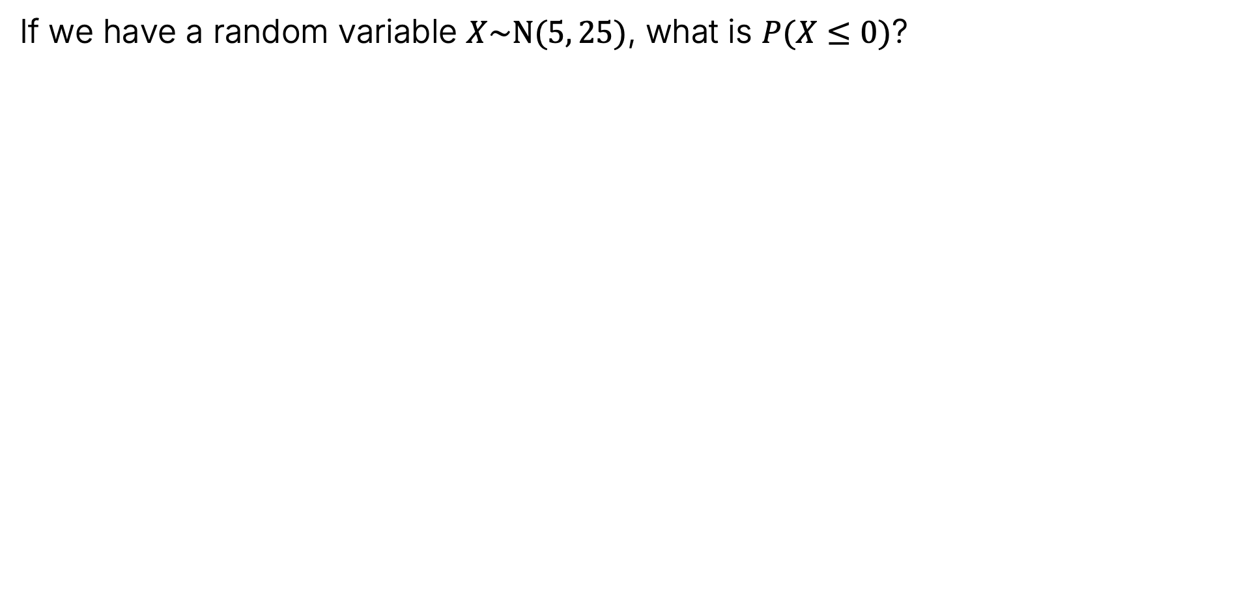
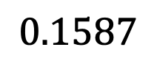

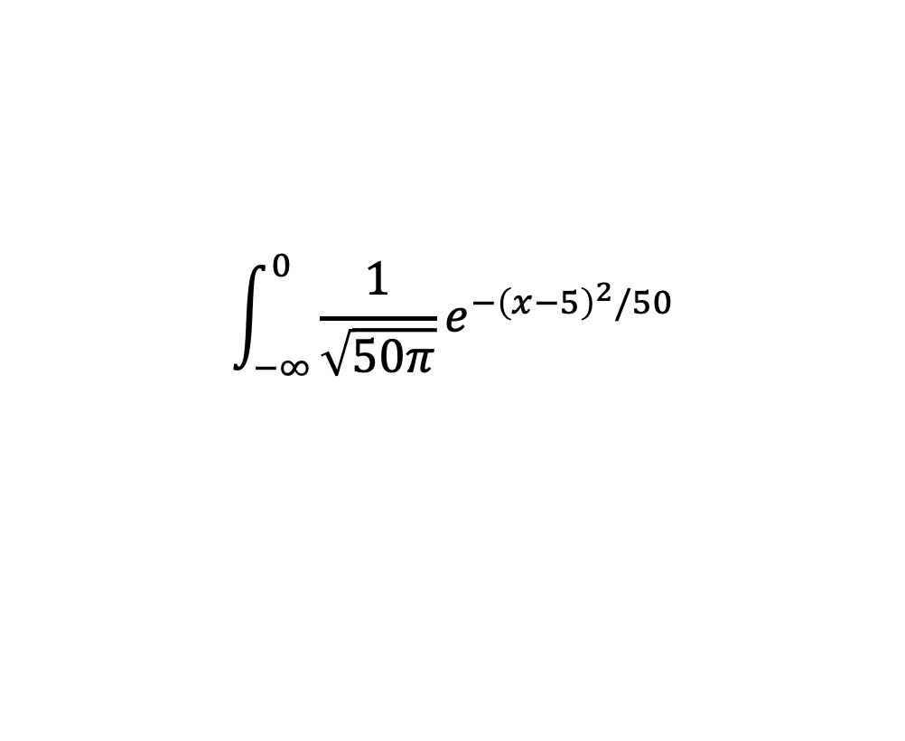
Computing the Probability of an Event
If we have a random variable $X\sim N(5, 25)$, what is $P(X≤0)$?
$$\int_{−∞}^{0}{\frac{1}{\sqrt{50π}}e^{{−\left(x−5\right)}^{2}/50}}$$
$$≈$$
$$0.1587$$

Slide 16
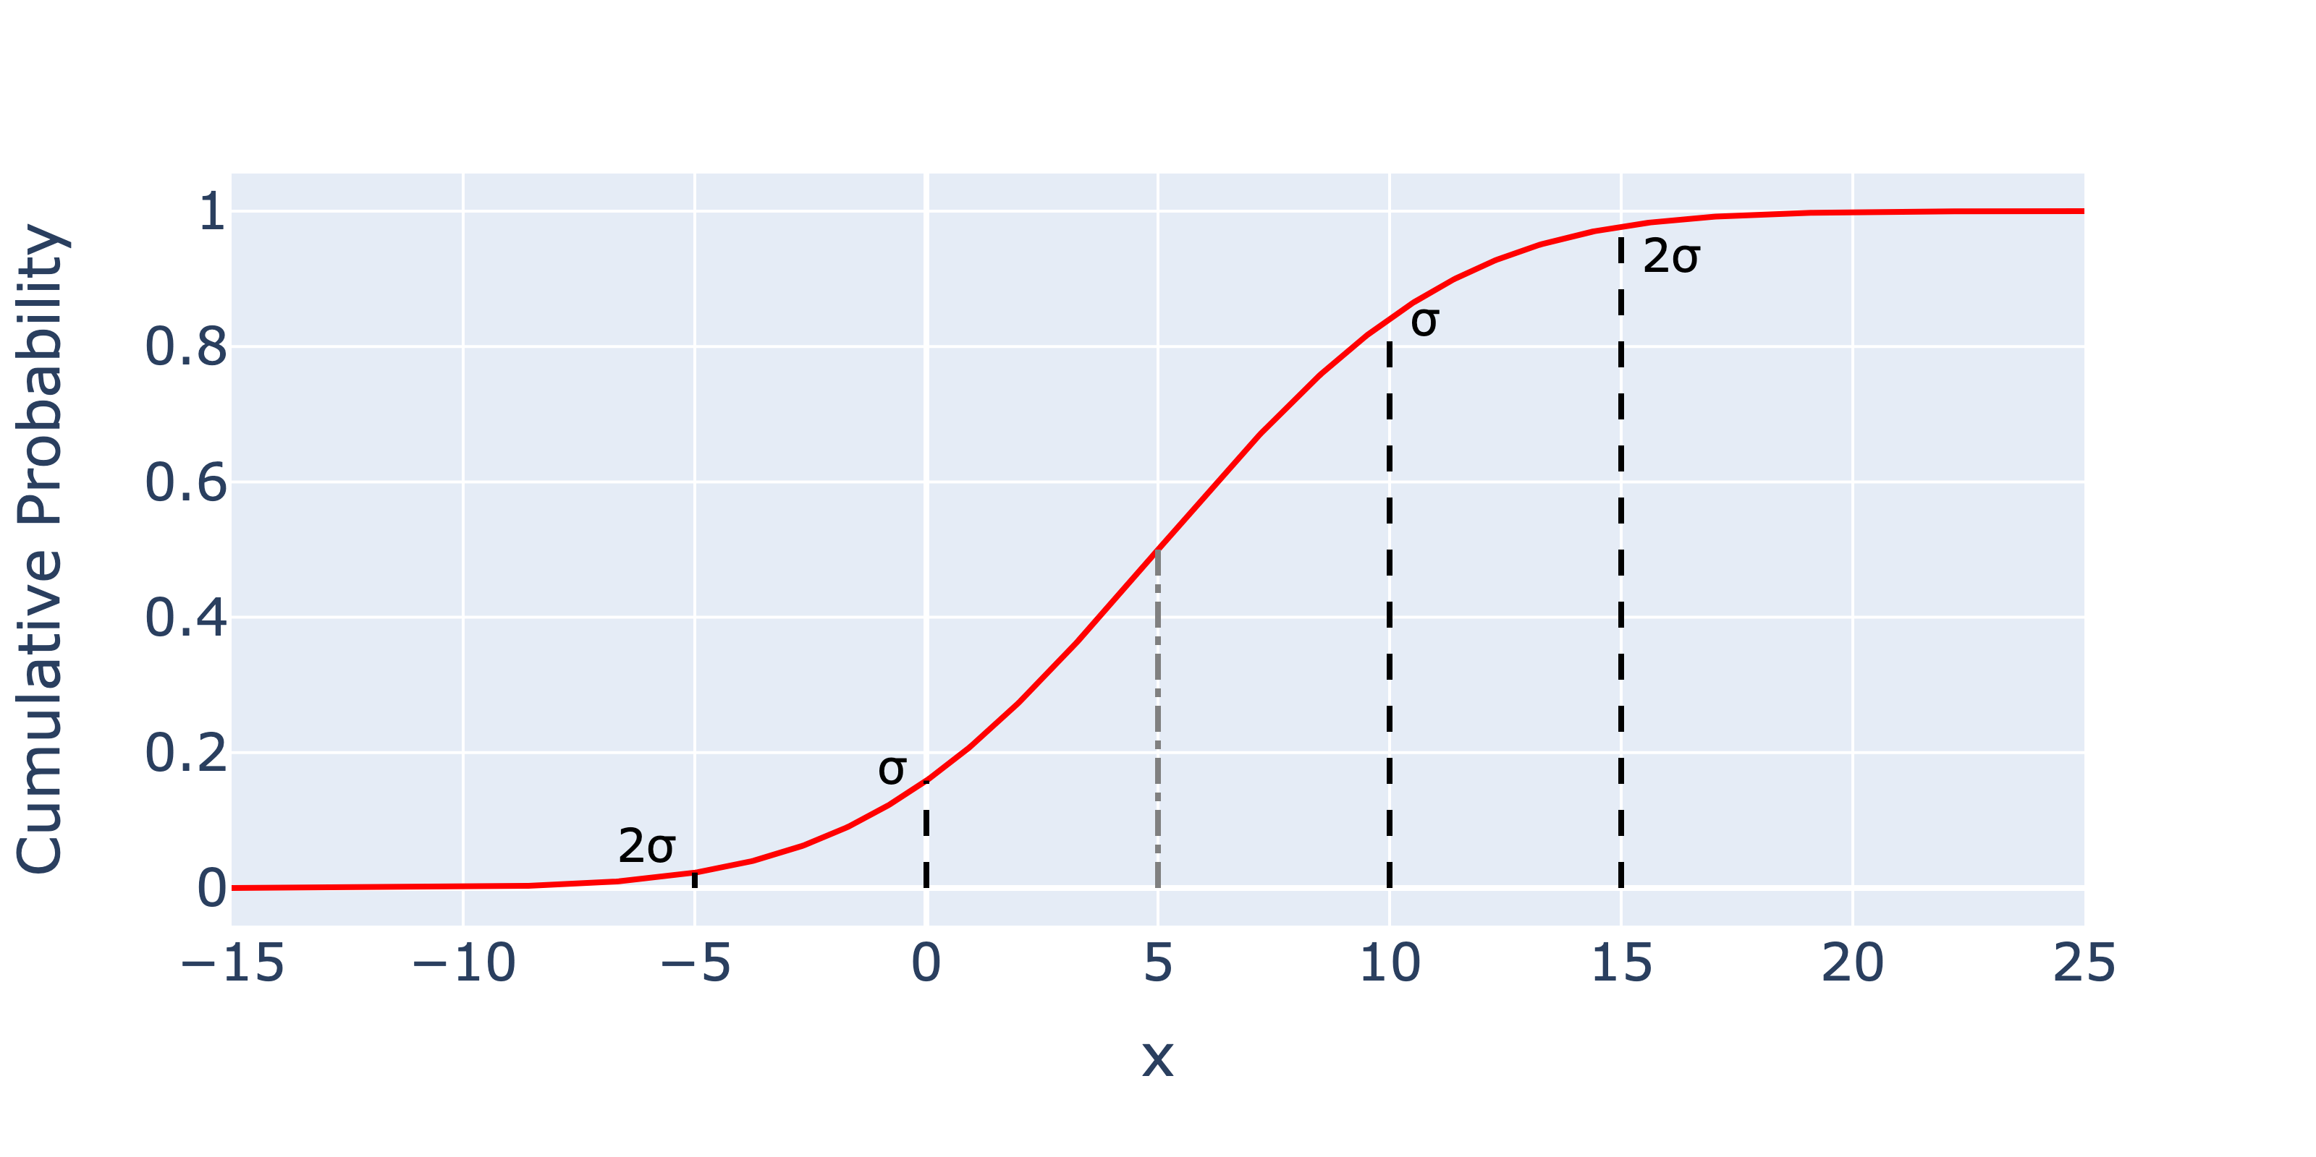
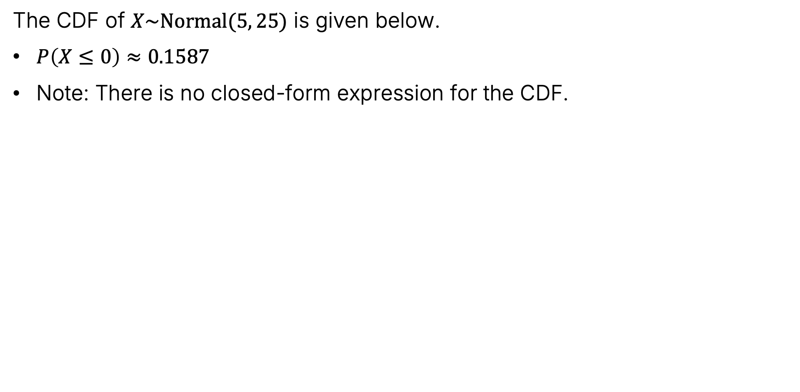

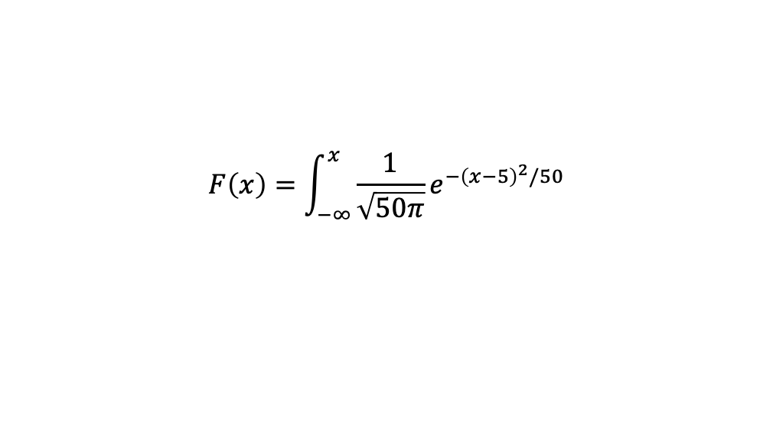
The CDF of a Gaussian
The CDF of $X\sim Normal(5, 25)$ is given below.
$P\left(X≤0\right)≈0.1587$
Note: There is no closed-form expression for the CDF.
$$F\left(x\right)=\int_{−∞}^{x}{\frac{1}{\sqrt{50π}}e^{{−\left(x−5\right)}^{2}/50}}$$

Slide 17
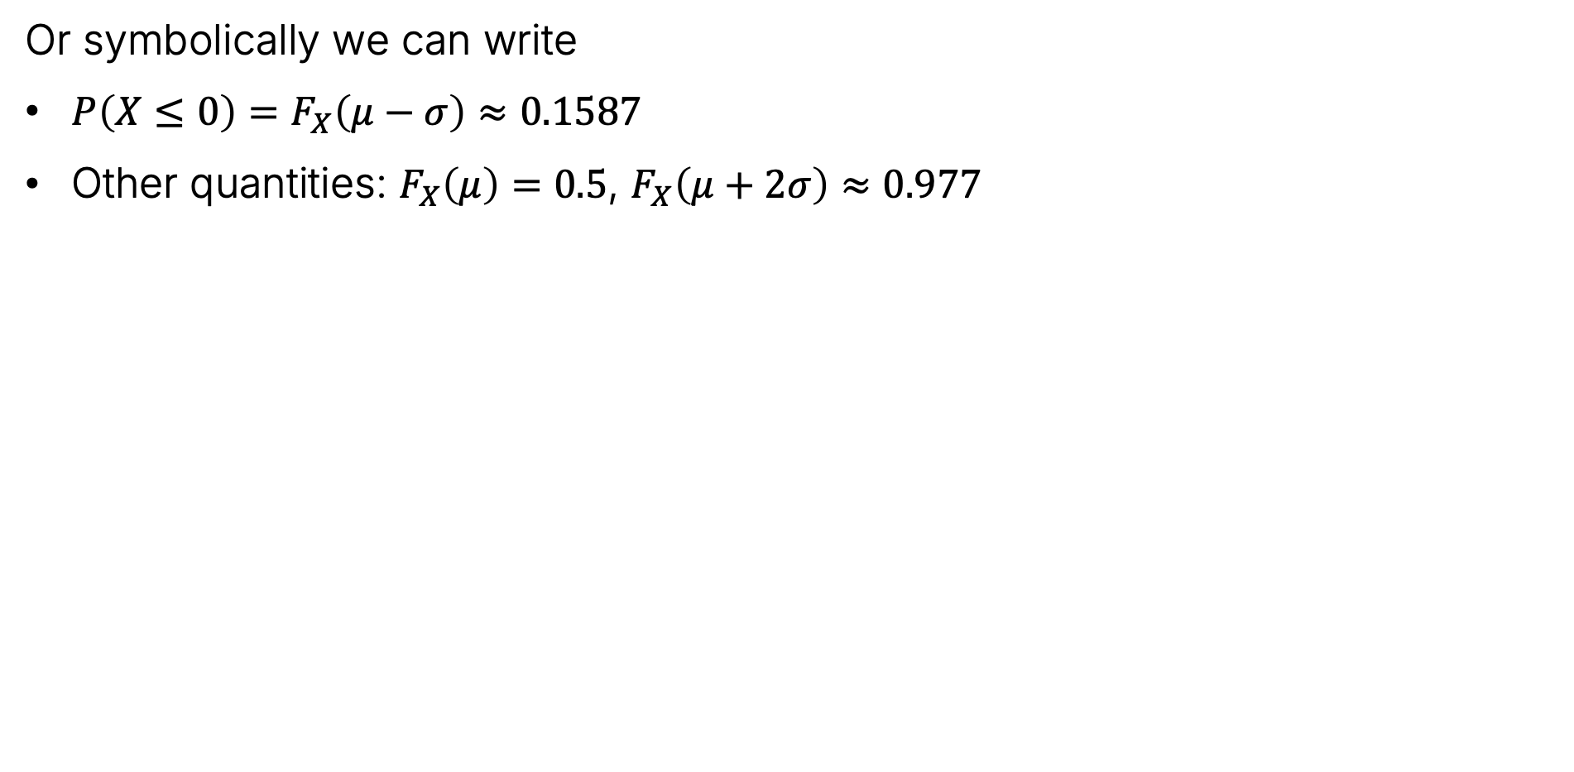

The CDF of a Gaussian
Or symbolically we can write
$P\left(X≤0\right)=F_{X}\left(μ−σ\right)≈0.1587$
Other quantities: $F_{X}\left(μ\right)=0.5$, $F_{X}\left(μ+2σ\right)≈0.977$
$$F\left(x\right)=\int_{−∞}^{x}{\frac{1}{\sqrt{50π}}e^{{−\left(x−5\right)}^{2}/50}}$$

Slide 18
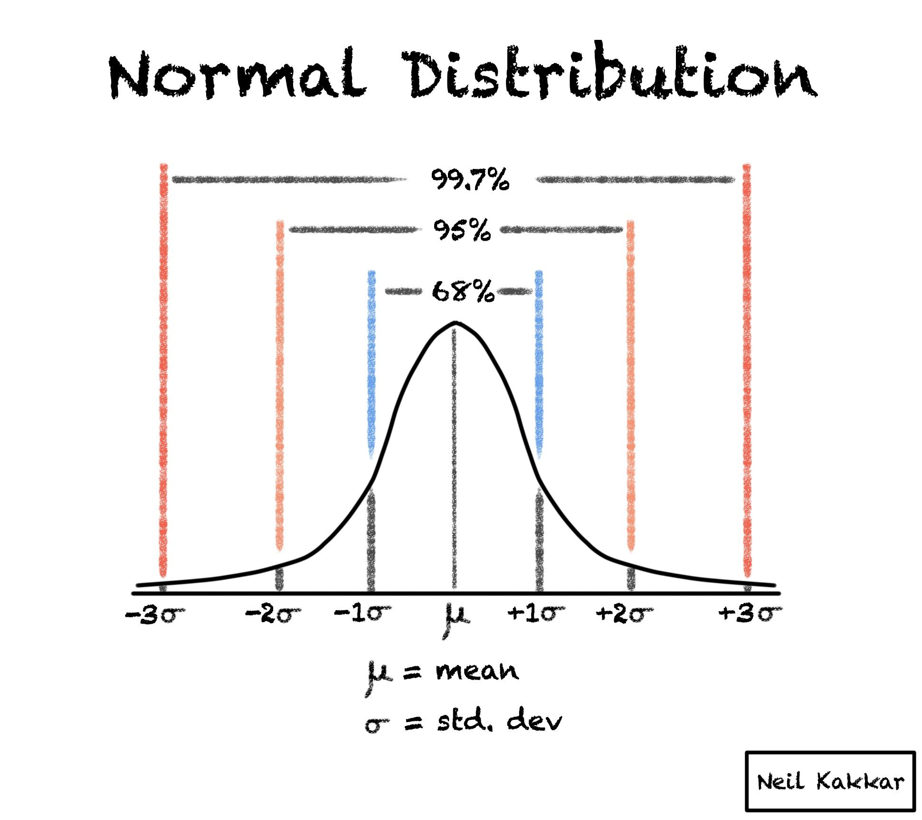

The 68–95–99.7 rule
The 68-95-99.7 rule tells us that for a normally distributed random variable:
~68% of the mass is within one standard deviation.
95% of the mass is within two standard deviations.
99.7% of the mass is within three standard deviations.
The “Z-score” is the number of standard deviations you are from the mean.
Link to blog

Slide 19
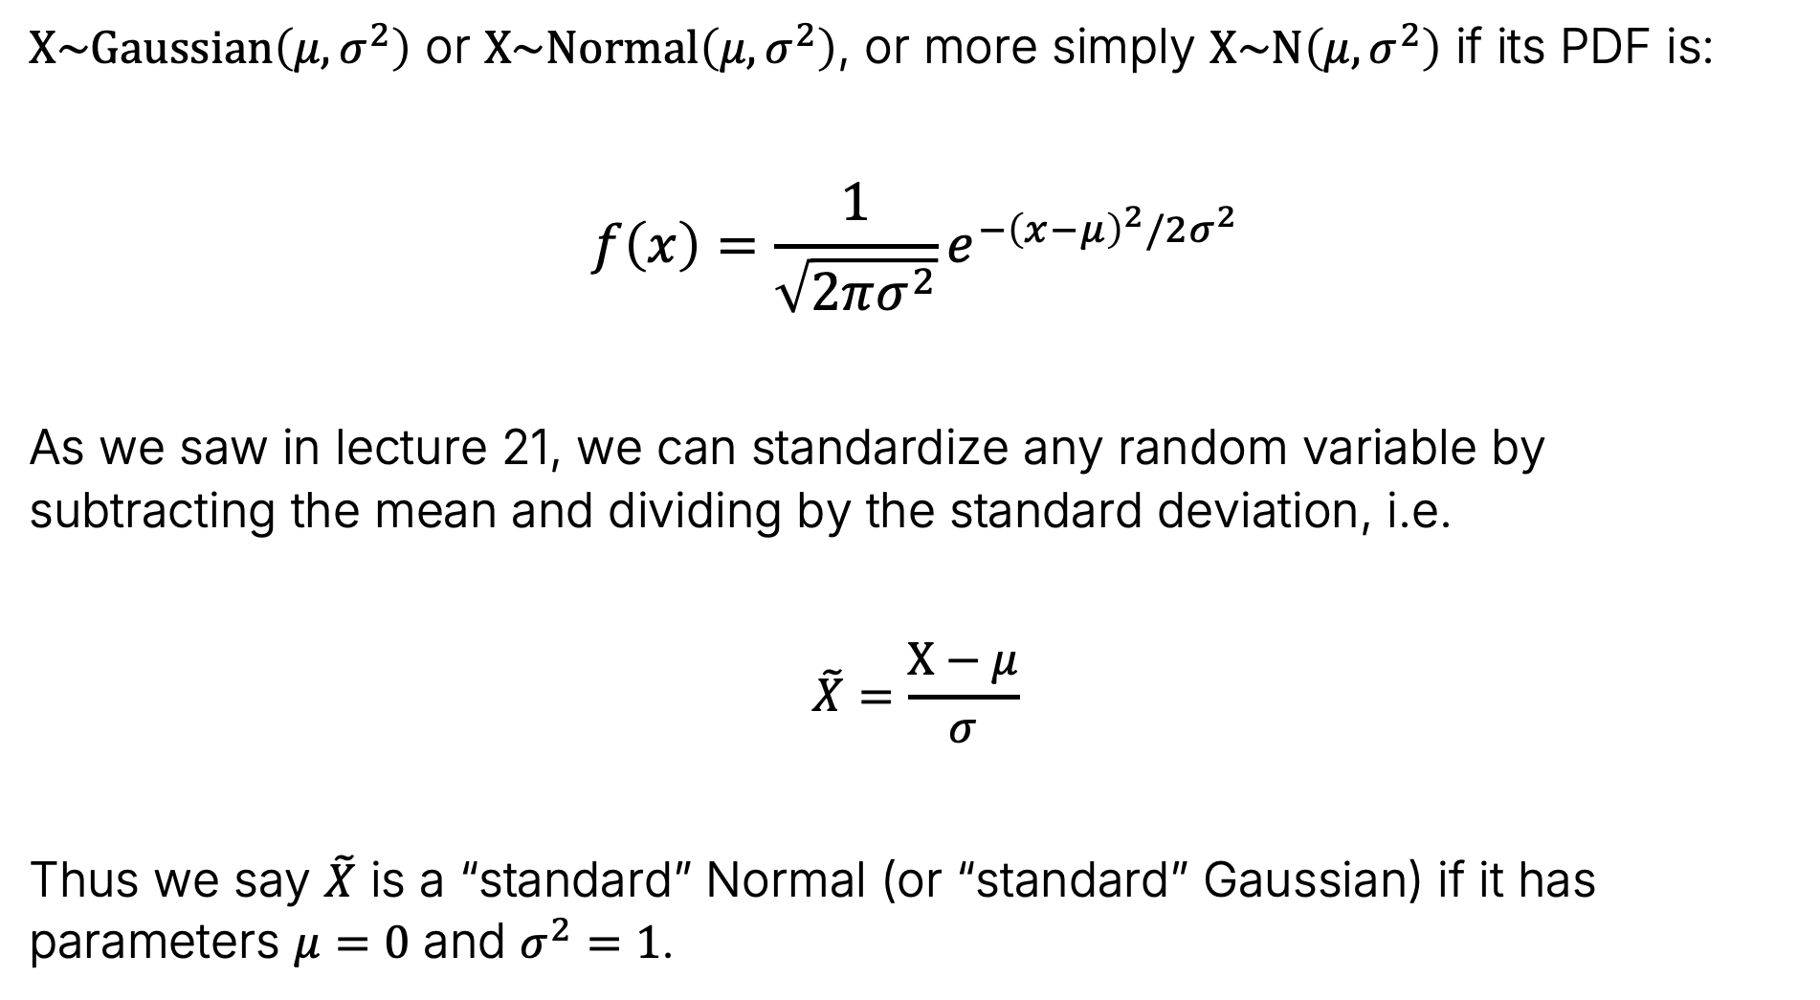

Normal (Gaussian) Distribution
$X\sim Gaussian\left(μ, σ^{2}\right)$ or $X\sim Normal\left(μ, σ^{2}\right)$, or more simply $X\sim N\left(μ, σ^{2}\right)$ if its PDF is:
$$f\left(x\right)=\frac{1}{\sqrt{2πσ^{2}}}e^{{−\left(x−μ\right)}^{2}/2σ^{2}}$$
As we saw in lecture 21, we can standardize any random variable by subtracting the mean and dividing by the standard deviation, i.e.
$$\tilde{X}=\frac{X−μ}{σ}$$
Thus we say $\tilde{X}$ is a “standard” Normal (or “standard” Gaussian) if it has parameters $μ=0$ and $σ^{2}=1$.

Slide 20
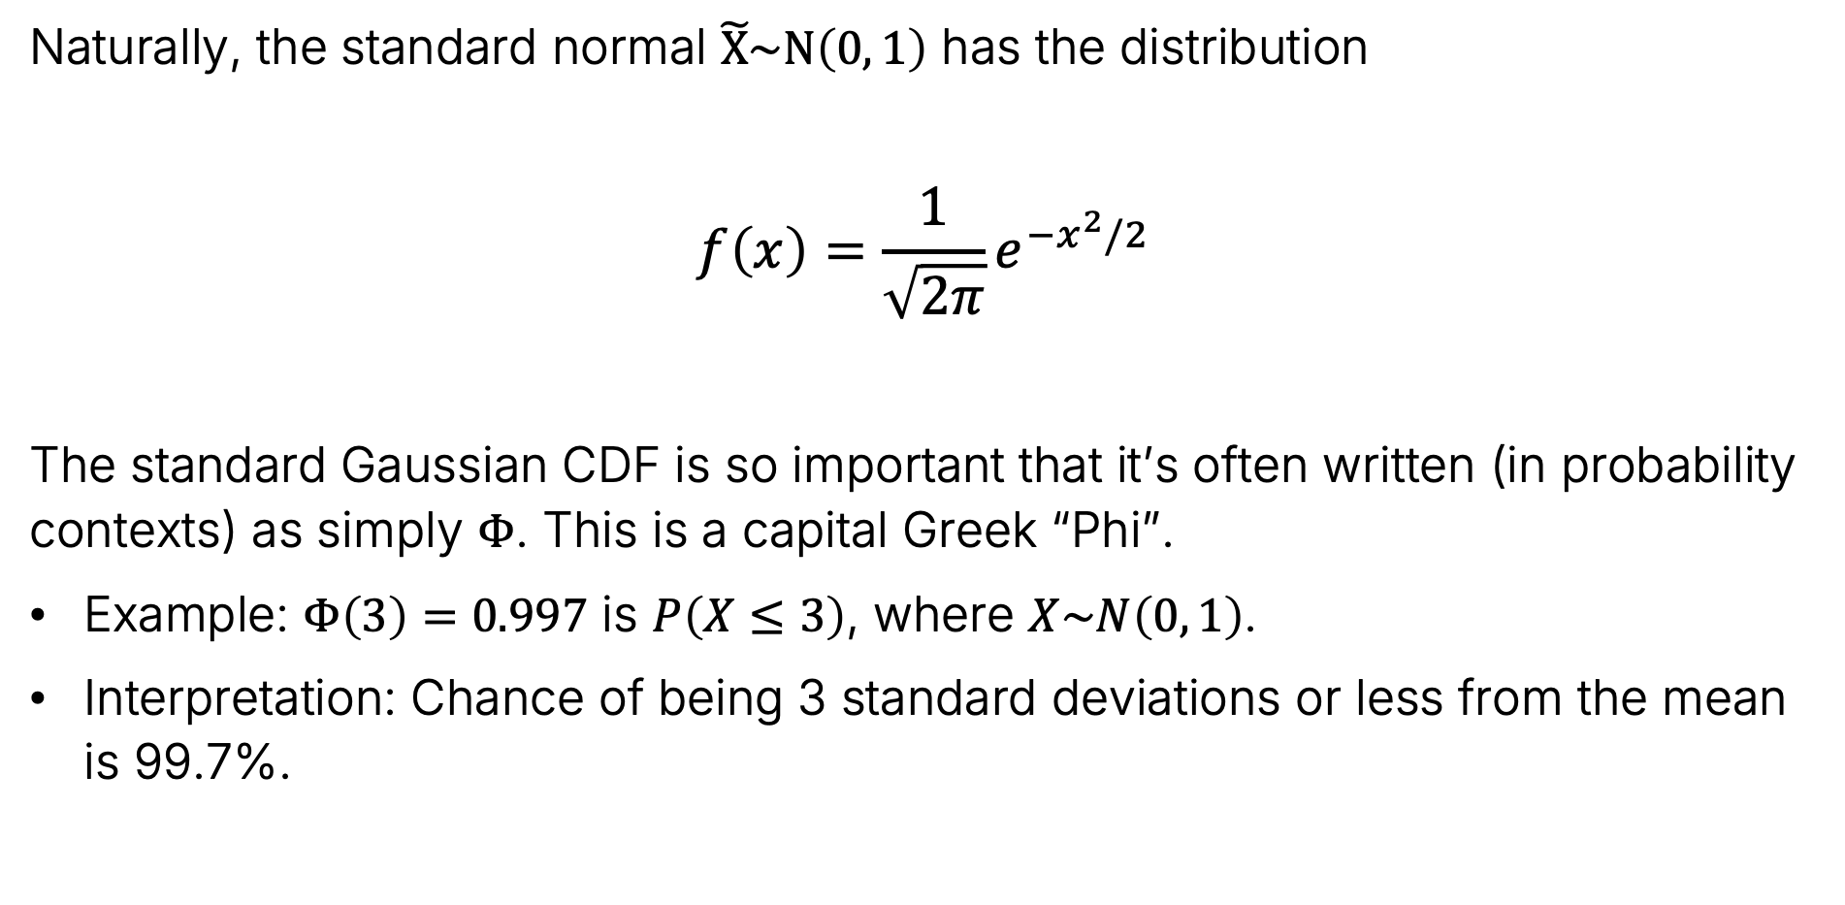
Normal (Gaussian) Distribution
Naturally, the standard normal $\tilde{X}\sim N\left(0, 1\right)$ has the distribution
$$f\left(x\right)=\frac{1}{\sqrt{2π}}e^{{−x}^{2}/2 }$$
The standard Gaussian CDF is so important that it’s often written (in probability contexts) as simply $Φ$. This is a capital Greek “Phi”.
Example: $Φ\left(3\right)=0.997$ is $P\left(X≤3\right)$, where $X\sim N\left(0, 1\right)$.
Interpretation: Chance of being 3 standard deviations or less from the mean is 99.7%.

Slide 21

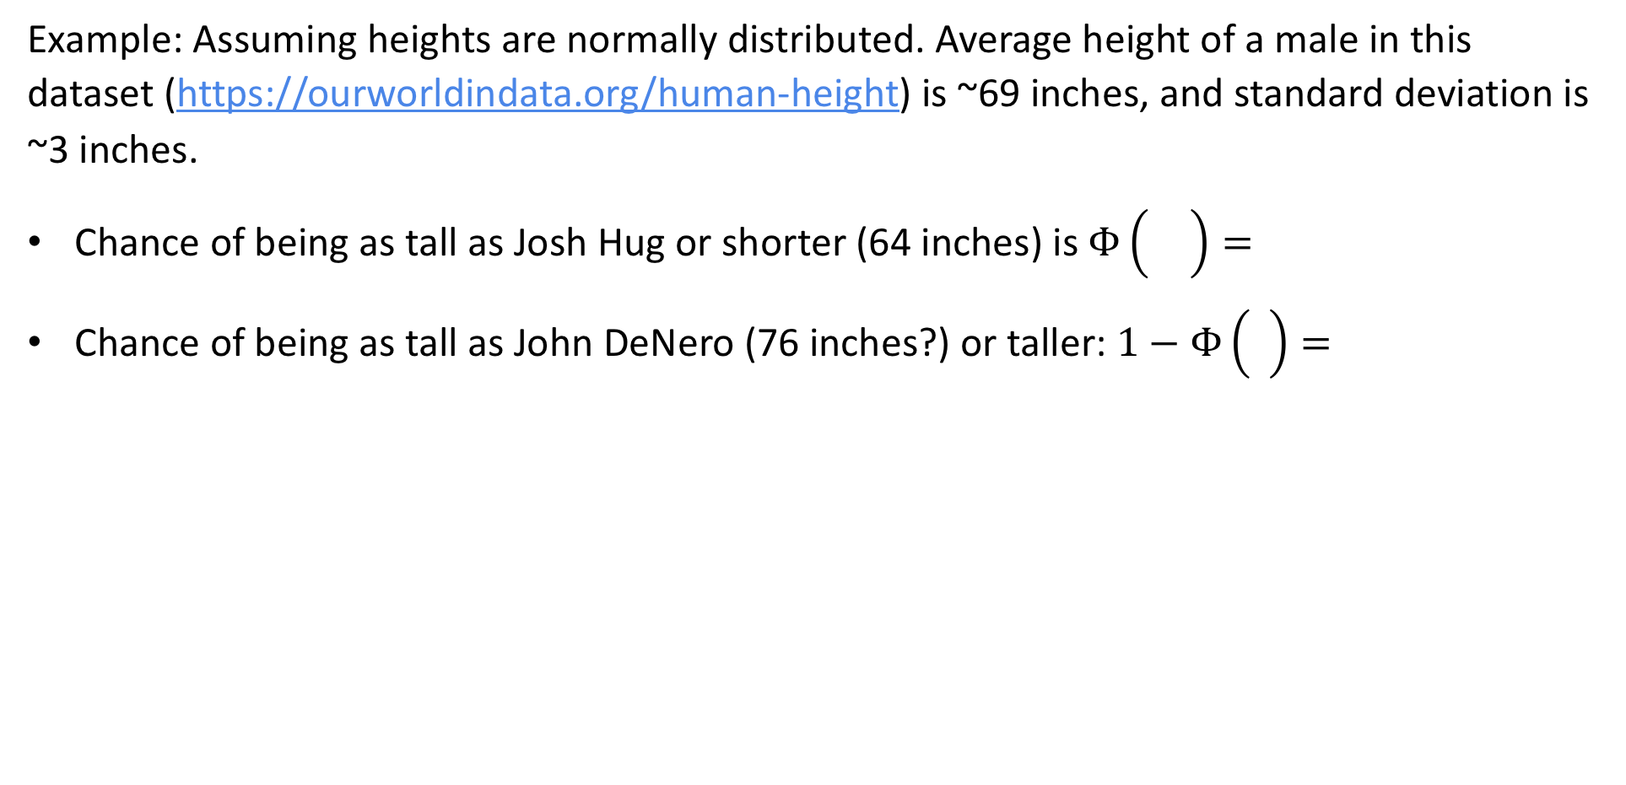
The Gaussian CDF $Φ$
Example: Assuming heights are normally distributed. Average height of a male in this dataset (https://ourworldindata.org/human-height) is ~69 inches, and standard deviation is ~3 inches.
Chance of being as tall as Josh Hug or shorter (64 inches) is $Φ\left(\frac{−5}{3}\right)=4.78\%$
Chance of being as tall as John DeNero (76 inches?) or taller: $1−Φ\left(\frac{7}{3}\right)=1\%$

Slide 22
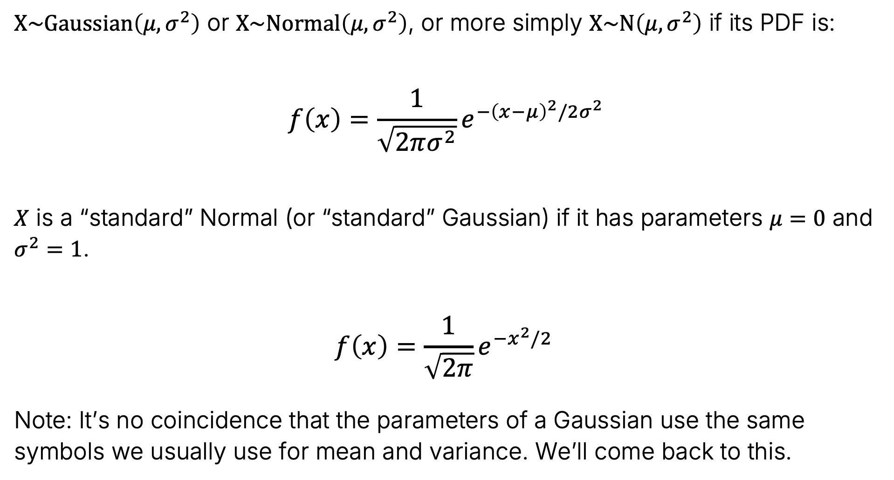
Normal (Gaussian) Distribution
$X\sim Gaussian\left(μ, σ^{2}\right)$ or $X\sim Normal\left(μ, σ^{2}\right)$, or more simply $X\sim N\left(μ, σ^{2}\right)$ if its PDF is:
$$f\left(x\right)=\frac{1}{\sqrt{2πσ^{2}}}e^{{−\left(x−μ\right)}^{2}/2σ^{2}}$$
$X$ is a “standard” Normal (or “standard” Gaussian) if it has parameters $μ=0$ and $σ^{2}=1$.
$$f\left(x\right)=\frac{1}{\sqrt{2π}}e^{{−x}^{2}/2 }$$
Note: It’s no coincidence that the parameters of a Gaussian use the same symbols we usually use for mean and variance. We’ll come back to this.

Slide 23
Affine Gaussian Transformations
Lecture 24, CS70 Fall 2025

Slide 24

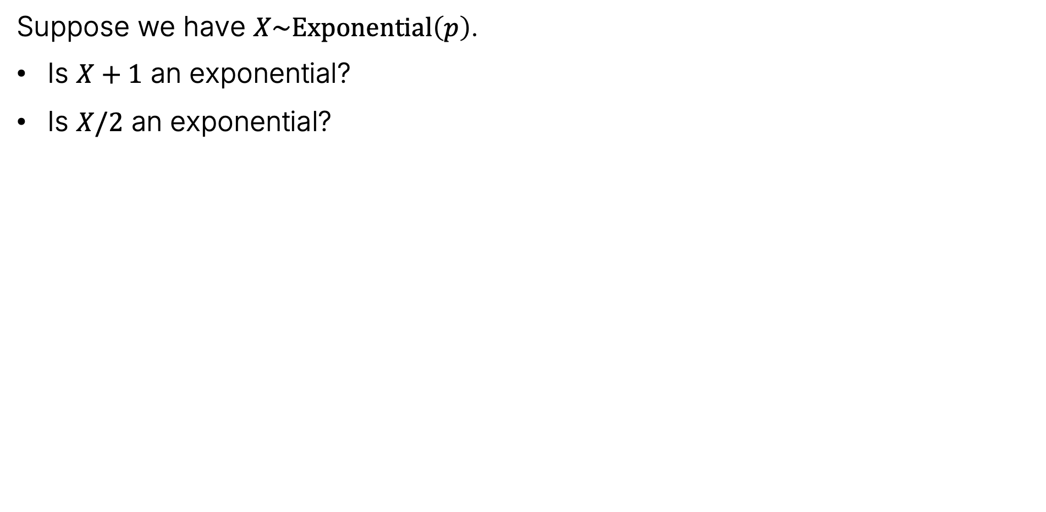
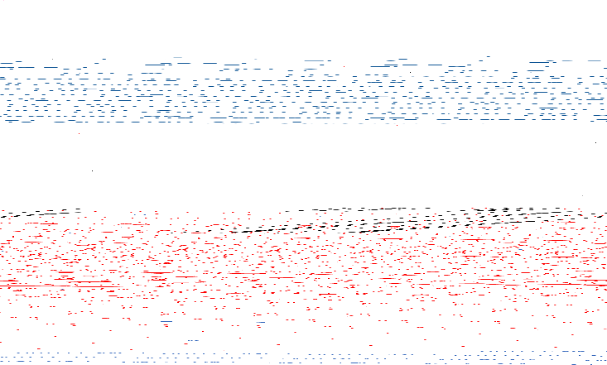
Question
Suppose we have $X\sim Exponential\left(p\right)$.
Is $X+1$ an exponential?
Is $X/2$ an exponential?
joshh.ug/A

Slide 25
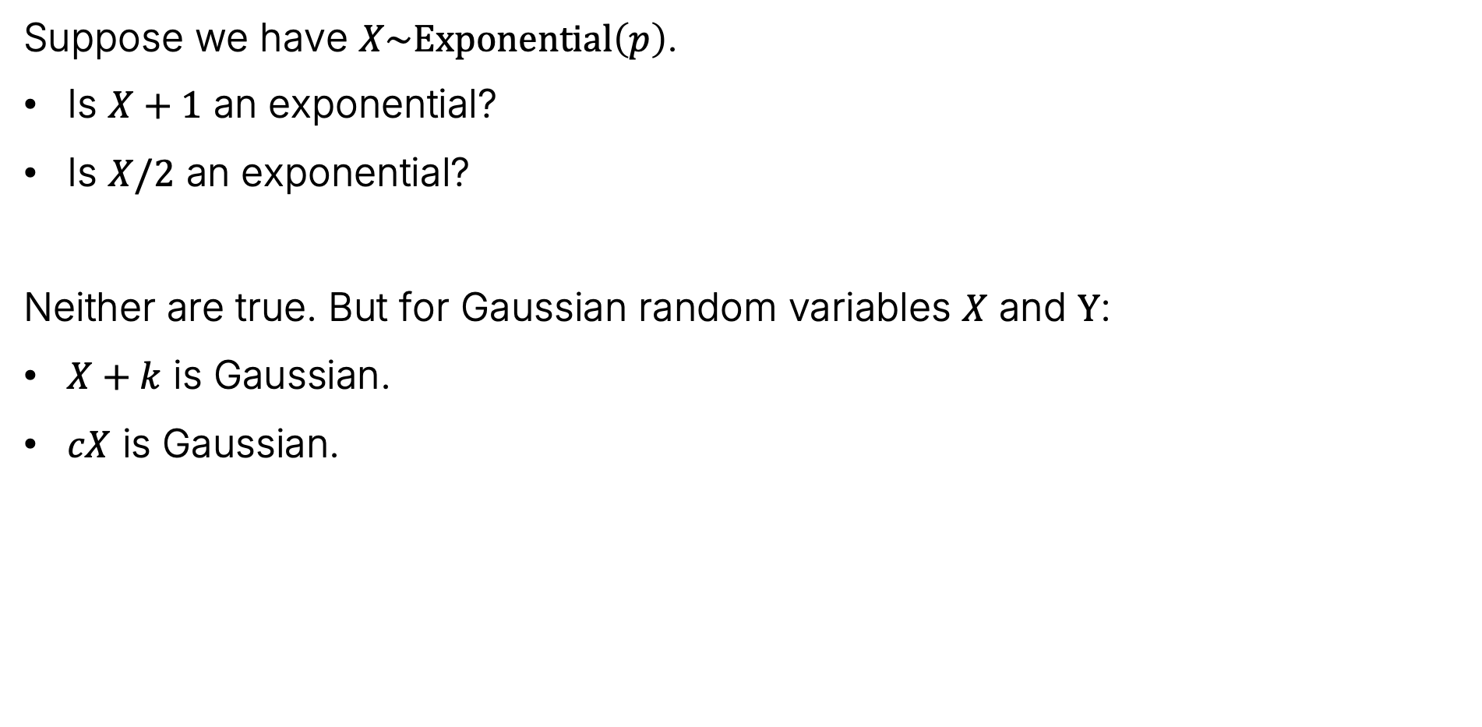

Question
Suppose we have $X\sim Exponential\left(p\right)$.
Is $X+1$ an exponential?
Is $X/2$ an exponential?
Neither are true. But for Gaussian random variables $X$ and $Y$:
$X+k$ is Gaussian.
$cX$ is Gaussian.
joshh.ug/A

Slide 26
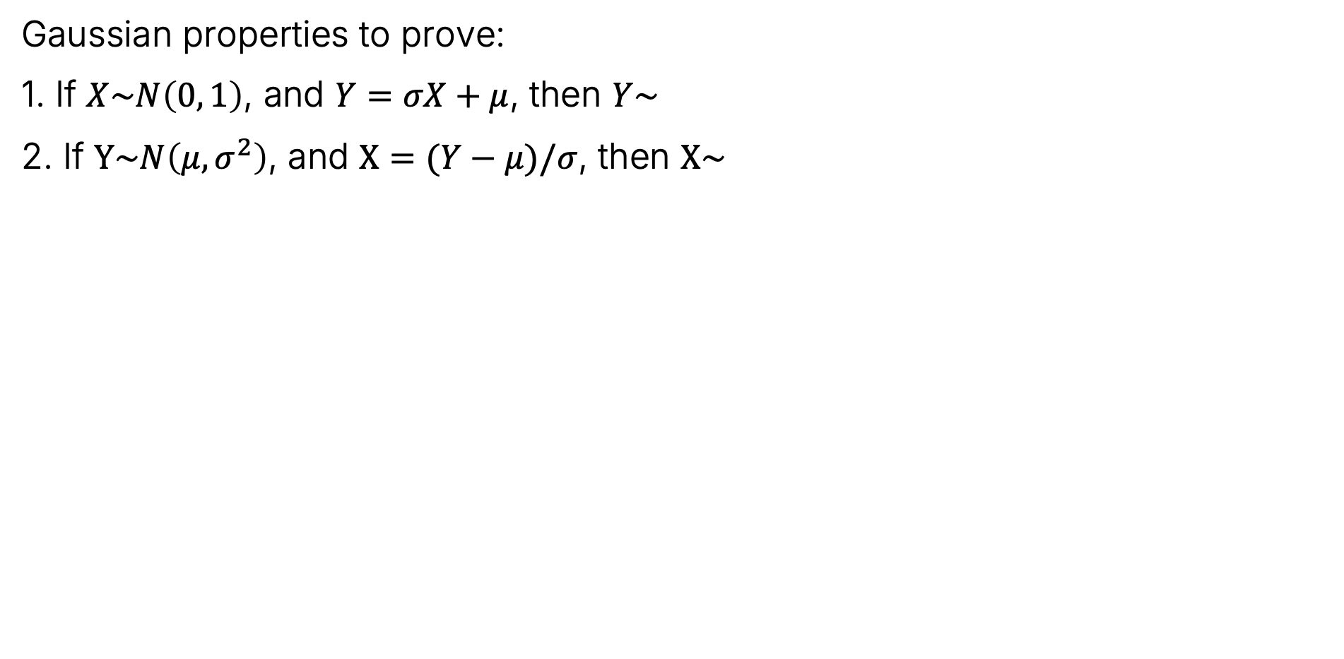

Gaussian
Gaussian properties to prove:
1. If $X\sim N\left(0, 1\right)$, and $Y=σX+μ$, then $Y\sim N\left(μ, σ^{2}\right)$
2. If $Y\sim N\left(μ,σ^{2}\right)$, and $X=(Y−μ)/σ$, then $X\sim N\left(0, 1\right)$

Slide 27
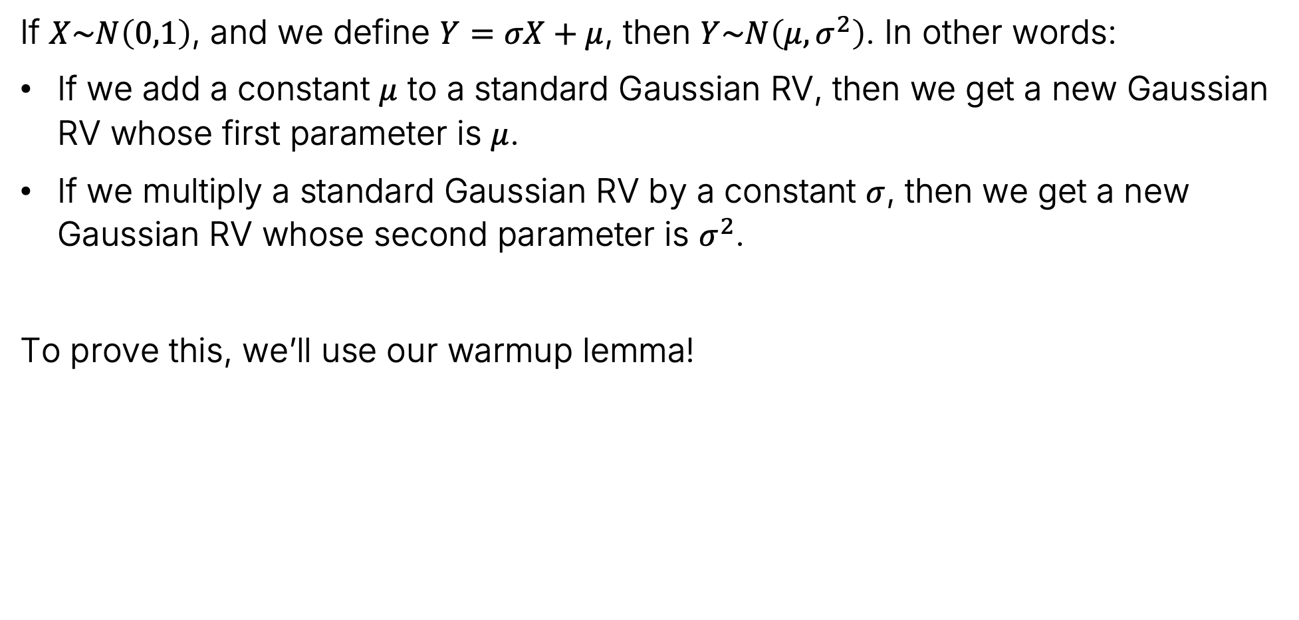
Property 1
If $X\sim N\left(0,1\right)$, and we define $Y=σX+μ$, then $Y\sim N\left(μ, σ^{2}\right)$. In other words:
If we add a constant $μ$ to a standard Gaussian RV, then we get a new Gaussian RV whose first parameter is $μ$.
If we multiply a standard Gaussian RV by a constant $σ$, then we get a new Gaussian RV whose second parameter is $σ^{2}$.
To prove this, we’ll use our warmup lemma!
Warmup Lemma
If $Y=aX+b$, then
$$f_{Y}\left(y\right)=f_{X}\left(\frac{y−b}{a}\right)⋅\frac{1}{a}$$

Slide 28

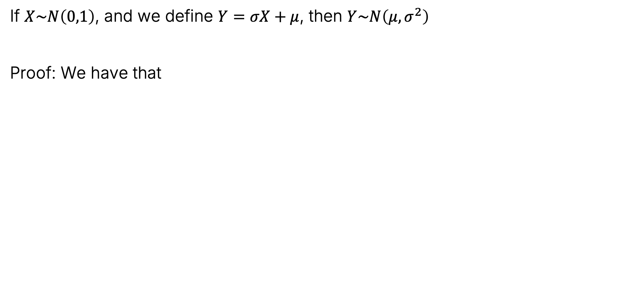


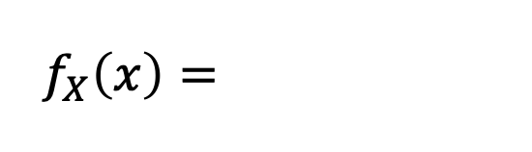
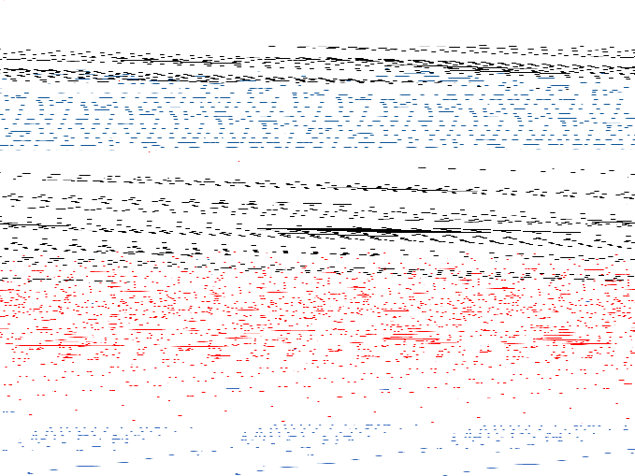
Property 1
If $X\sim N\left(0,1\right)$, and we define $Y=σX+μ$, then $Y\sim N\left(μ, σ^{2}\right)$
Proof: We have that
$$f_{X}\left(x\right)=\frac{1}{\sqrt{2π}}e^{−x^{2}/2 }$$
$$f_{Y}\left(y\right)=\frac{1}{σ}\frac{1}{\sqrt{2π}}e^{{−\left(\frac{y−μ}{σ}\right)}^{2}/2 }$$
$$=\frac{1}{\sqrt{2πσ^{2}}}e^{{−\left(y−μ\right)}^{2}/2σ^{2} }$$
Warmup Lemma
This is the PDF for $N\left(μ, σ^{2}\right)$
If $Y=aX+b$, then
$$f_{Y}\left(y\right)=f_{X}\left(\frac{y−b}{a}\right)⋅\frac{1}{a}$$

Slide 29

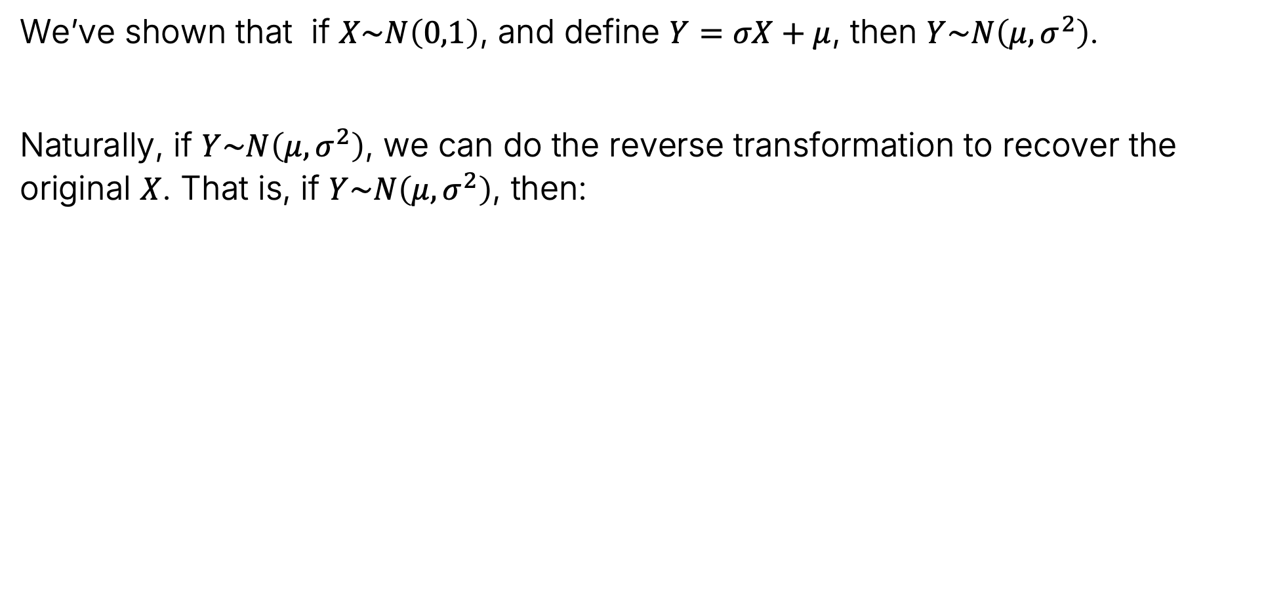

Property 2
We’ve shown that if $X\sim N\left(0,1\right)$, and define $Y=σX+μ$, then $Y\sim N\left(μ, σ^{2}\right)$.
Naturally, if $Y\sim N\left(μ,σ^{2}\right)$, we can do the reverse transformation to recover the original $X$. That is, if $Y\sim N\left(μ, σ^{2}\right)$, then:
$$X=\frac{Y−μ}{σ}\sim N(0, 1)$$

Slide 30

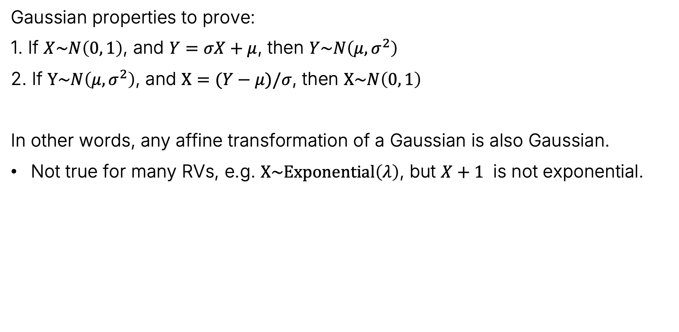
Reflection on Gaussian Properties
Gaussian properties to prove:
1. If $X\sim N\left(0, 1\right)$, and $Y=σX+μ$, then $Y\sim N\left(μ, σ^{2}\right)$
2. If $Y\sim N\left(μ,σ^{2}\right)$, and $X=(Y−μ)/σ$, then $X\sim N\left(0, 1\right)$
In other words, any affine transformation of a Gaussian is also Gaussian.
Not true for many RVs, e.g. $X\sim Exponential\left(λ\right)$, but $X+1$ is not exponential.

Slide 31
Gaussian Parameter Interpretation
Lecture 24, CS70 Fall 2025

Slide 32
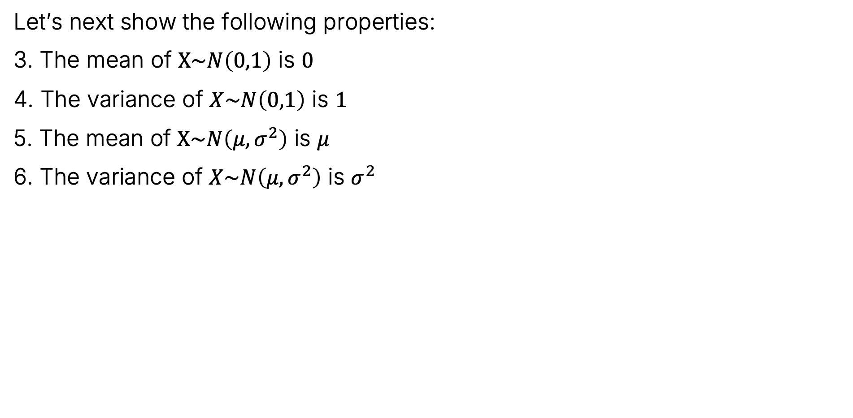

Gaussian
Let’s next show the following properties:
3. The mean of $X\sim N\left(0,1\right)$ is $0$
4. The variance of $X\sim N\left(0,1\right)$ is $1$
5. The mean of $X\sim N\left(μ,σ^{2}\right)$ is $μ$
6. The variance of $X\sim N\left(μ,σ^{2}\right)$ is $σ^{2}$

Slide 33
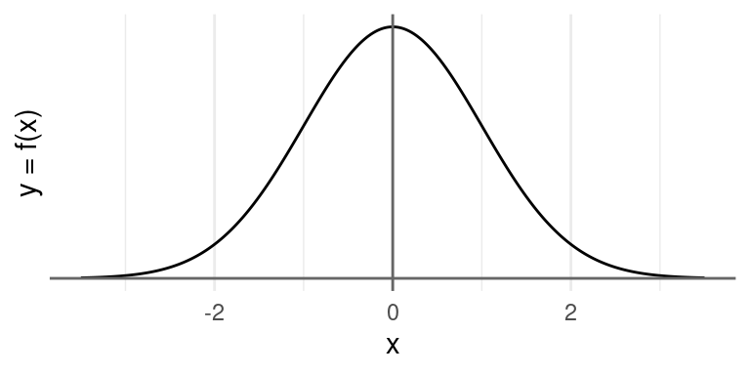
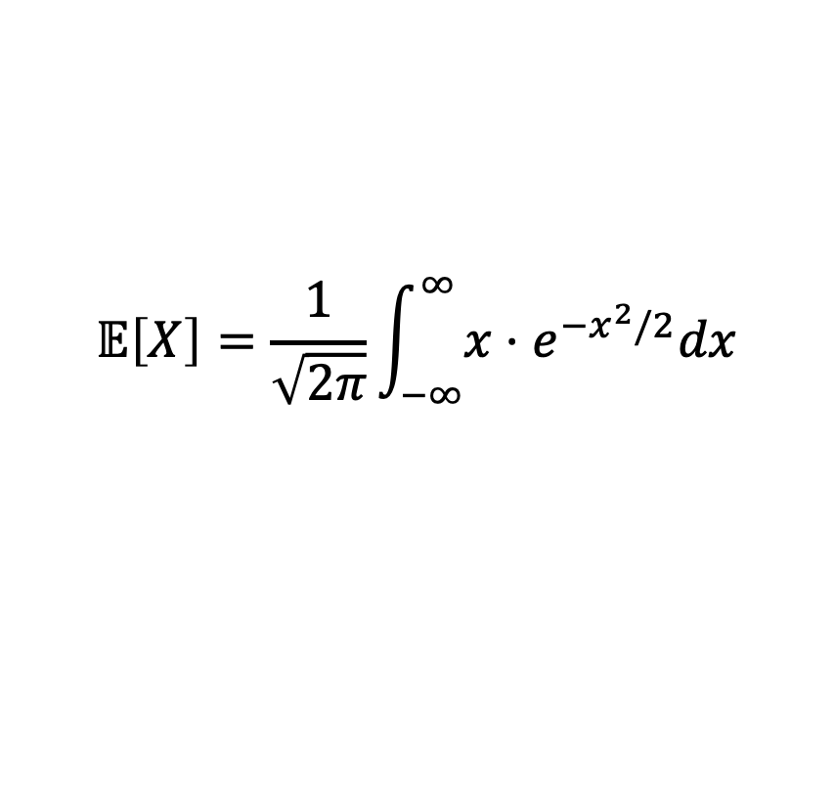
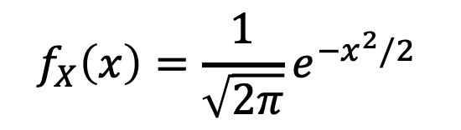

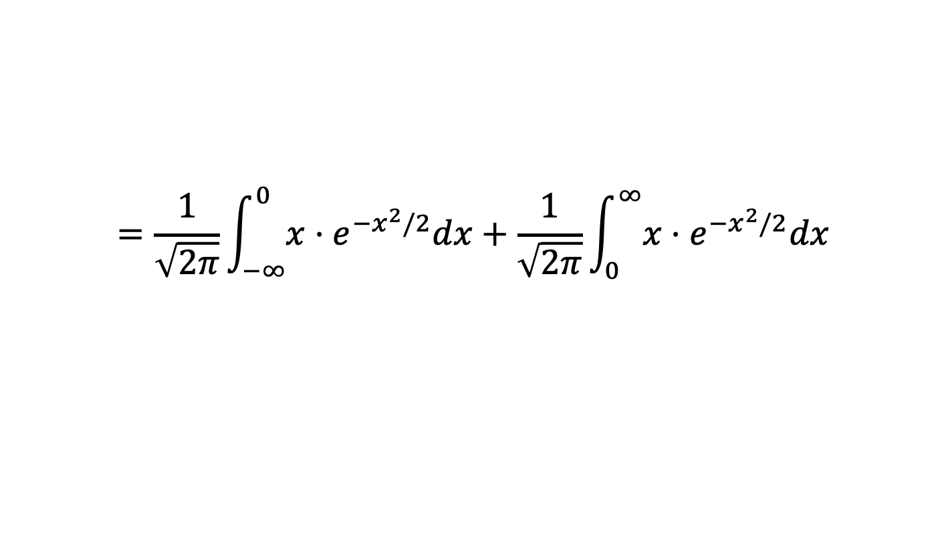
Expectation of a Standard Gaussian Random Variable
$$f_{X}\left(x\right)=\frac{1}{\sqrt{2π}}e^{{−x}^{2}/2 }$$
If $X\sim Gaussian(0, 1)$, then $𝔼\left[X\right]=0$. Proof:
$$𝔼\left[X\right]=\frac{1}{\sqrt{2π}}\int_{−∞}^{∞}{x⋅e^{−x^{2}/2}dx}$$
Cancel out exactly!
$$=\frac{1}{\sqrt{2π}}\int_{−∞}^{0}{x⋅e^{−x^{2}/2}dx}+\frac{1}{\sqrt{2π}}\int_{0}^{∞}{x⋅e^{−x^{2}/2}dx}$$
$$=0$$
Another view: The expected value of any distribution symmetric around zero is zero. The PDF of a standard Gaussian looks like this:
Figure from Stat 20

Slide 34
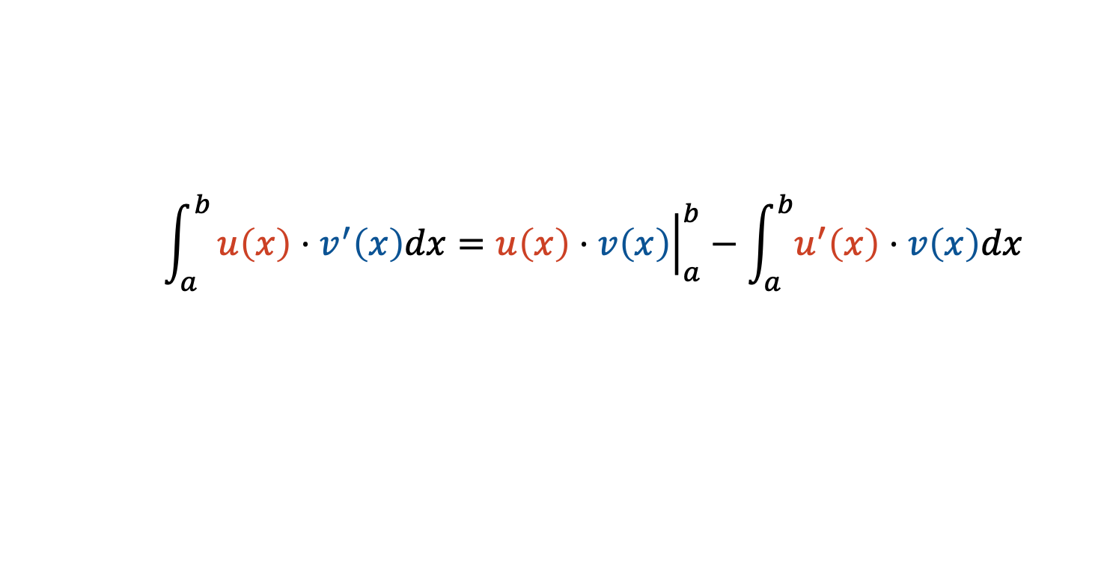
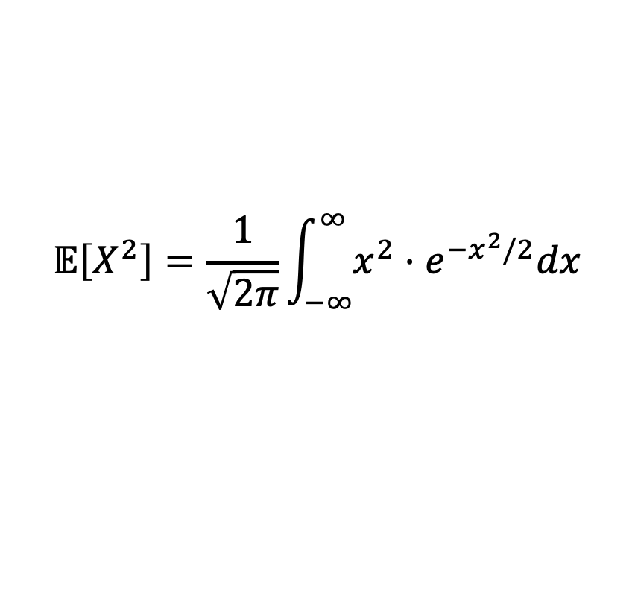
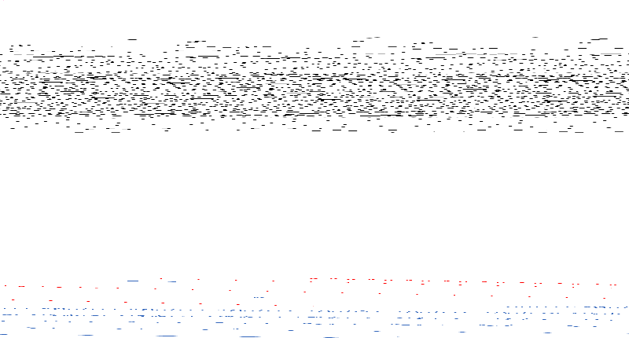
Variance of a Standard Gaussian Random Variable
$$f_{X}\left(x\right)=\frac{1}{\sqrt{2π}}e^{−x^{2}/2 }$$
If $X\sim Gaussian(0, 1)$, then $var\left(X\right)=𝔼\left[X^{2}\right]=1$. Proof:
$var\left(X\right)=𝔼\left[X^{2}\right]−𝔼{\left[X\right]}^{2}$, and we already know $𝔼{\left[X\right]}^{2}=0$
$$𝔼\left[X^{2}\right]=\frac{1}{\sqrt{2π}}\int_{−∞}^{∞}{x^{2}⋅e^{−x^{2}/2}dx}$$
Integrate by parts where $u\left(x\right)=−x$ and $v^{′}\left(x\right)=−xe^{−x^{2}/2}$
$$\int_{a}^{b}{u\left(x\right)⋅v^{′}\left(x\right)dx={\left.u\left(x\right)⋅v\left(x\right)\right|}_{a}^{b}}−\int_{a}^{b}{u^{′}\left(x\right)⋅v\left(x\right)dx}$$

Slide 35





Variance of a Standard Gaussian Random Variable
$$f_{X}\left(x\right)=\frac{1}{\sqrt{2π}}e^{−x^{2}/2 }$$
If $X\sim Gaussian(0, 1)$, then $var\left(X\right)=𝔼\left[X^{2}\right]=1$. Proof:
$var\left(X\right)=𝔼\left[X^{2}\right]−𝔼{\left[X\right]}^{2}$, and we already know $𝔼{\left[X\right]}^{2}=0$
$$𝔼\left[X^{2}\right]=\frac{1}{\sqrt{2π}}\int_{−∞}^{∞}{x^{2}⋅e^{−x^{2}/2}dx}$$
Integrate by parts where $u\left(x\right)=−x$ and $v^{′}\left(x\right)=−xe^{−x^{2}/2}$
$${\left.=\frac{1}{\sqrt{2π}}(−x)⋅\left(e^{−x^{2}/2}\right)\right|}_{−∞}^{∞}$$
$$+\frac{1}{\sqrt{2π}}\int_{−∞}^{∞}{−1⋅−e^{−x^{2}/2}}$$
$${\left.=\frac{1}{\sqrt{2π}}⋅\frac{−x}{e^{x^{2}/2}} \right|}_{−∞}^{∞}$$
$$+\int_{−∞}^{∞}{f\left(x\right) dx}$$
https://joshh.ug/B
What are A and B?

Slide 36


Variance of a Standard Gaussian Random Variable
$$f_{X}\left(x\right)=\frac{1}{\sqrt{2π}}e^{−x^{2}/2 }$$
If $X\sim Gaussian(0, 1)$, then $var\left(X\right)=𝔼\left[X^{2}\right]=1$. Proof:
$var\left(X\right)=𝔼\left[X^{2}\right]−𝔼{\left[X\right]}^{2}$, and we already know $𝔼{\left[X\right]}^{2}=0$
$$𝔼\left[X^{2}\right]=\frac{1}{\sqrt{2π}}\int_{−∞}^{∞}{x^{2}⋅e^{−x^{2}/2}dx}$$
Integrate by parts where $u\left(x\right)=−x$ and $v^{′}\left(x\right)=−xe^{−x^{2}/2}$
$${\left.=\frac{1}{\sqrt{2π}}(−x)⋅\left(e^{−x^{2}/2}\right)\right|}_{−∞}^{∞}$$
$$+\frac{1}{\sqrt{2π}}\int_{−∞}^{∞}{−1⋅−e^{−x^{2}/2}}$$
$${\left.=\frac{1}{\sqrt{2π}}⋅\frac{−x}{e^{x^{2}/2}} \right|}_{−∞}^{∞}$$
$$+\int_{−∞}^{∞}{f\left(x\right) dx}$$
$$=0+1$$
This is just the PDF of a Gaussian, which must integrate to 1.
Intuition or L'Hôpital

Slide 37

Gaussian
Gaussian properties to prove:
3. The mean of $X\sim N\left(0,1\right)$ is $0$
4. The variance of $X\sim N\left(0,1\right)$ is $1$
5. The mean of $X\sim N\left(μ,σ^{2}\right)$ is $μ$
6. The variance of $X\sim N\left(μ,σ^{2}\right)$ is $σ^{2}$
Now let’s show properties 5 and 6.

Slide 38






Proof of Properties 5 and 6
Suppose $X\sim N\left(0, 1\right)$, and $Y=σX+μ$.
That means that $𝔼\left[Y\right]=𝔼\left[σX+μ\right]=σ𝔼\left[X\right]+μ$
And $var\left(Y\right)=var\left(σX+μ\right)=σ^{2}var\left(X\right)$
$$=0+μ=μ$$
Property 3: $𝔼\left[X\right]=0$
$$=σ^{2}$$
Property 4: $var(X)=1$

Slide 39

Gaussian
Gaussian properties we’ve proven:
1. If $X\sim N\left(0, 1\right)$, and $Y=σX+μ$, then $Y\sim N\left(μ, σ^{2}\right)$
2. If $Y\sim N\left(μ,σ^{2}\right)$, and $X=(Y−μ)/σ$, then $X\sim N\left(0, 1\right)$
3. The mean of $X\sim N\left(0,1\right)$ is $0$
4. The variance of $X\sim N\left(0,1\right)$ is $1$
5. The mean of $X\sim N\left(μ,σ^{2}\right)$ is $μ$
6. The variance of $X\sim N\left(μ,σ^{2}\right)$ is $σ^{2}$

Slide 40


Reflection on Gaussian Properties
Gaussian properties to prove:
1. If $X\sim N\left(0, 1\right)$, and $Y=σX+μ$, then $Y\sim N\left(μ, σ^{2}\right)$
2. If $Y\sim N\left(μ,σ^{2}\right)$, and $X=(Y−μ)/σ$, then $X\sim N\left(0, 1\right)$
5. The mean of $X\sim N\left(μ,σ^{2}\right)$ is $μ$
6. The variance of $X\sim N\left(μ,σ^{2}\right)$ is $σ^{2}$
Thus we have that:
Any affine transformation of a Gaussian is also Gaussian.
A Gaussian RV has exactly two free parameters which are its mean and variance.
Not true for our other RVs, e.g. if $X\sim Geometric\left(p\right)$, then we have that $var\left(X\right)=(1−p)/p^{2}$, $\text{𝔼}\text{[}\text{X}\text{]=1/}\text{p}$. Can’t set independently.

Slide 41
Summing Gaussians
Lecture 24, CS70 Fall 2025

Slide 42


The Sum of Independent Gaussians is Gaussian
Another remarkable property of the Gaussian distribution is that the sum of two independent Gaussians is always also Gaussian.
Which of the following distributions have this property?
Bernoulli
Binomial
Uniform
https://joshh.ug/C
This is a tricky question!

Slide 43

The Sum of Independent Gaussians is Gaussian
Another remarkable property of the Gaussian distribution is that the sum of two independent Gaussians is always also Gaussian.
Which of the following distributions have this property?
Bernoulli, no except for the degenerate case where $p=0$.
Binomial, yes but only if they have the same $p$.
Uniform, no except for the degenerate case where there is only one possible outcome.
(so all of them can be yes or no)

Slide 44




Detour: Joint Distribution of Two Independent Standard Normals
Earlier, we saw that if $X$ and $Y$ are independent, then $f\left(X, Y\right)=f\left(x\right)⋅f\left(y\right)$.
Thus, the joint distribution of two standard normal (a.k.a. Gaussian) RVs is:
$$f\left(X,Y\right)=\frac{1}{\sqrt{2π}}e^{{−x}^{2}/2 }⋅\frac{1}{\sqrt{2π}}e^{{−y}^{2}/2 }$$
$$=\frac{1}{\sqrt{2π}}e^{{−(x}^{2}+y^{2})/2 }$$

Slide 45

Detour: Visualizing the Joint Distribution of Two Independent Standard Normals
Below we see a plot of the joint PDF (from the notes*).
Interactive version: https://joshh.ug/cs70/joint_gaussian_pdf.html
*: Figure ultimately comes from “Why Is the Sum of Independent Normal Random Variables Normal” by by B. Eisenberg and R. Sullivan, Mathematics Magazine, Vol. 81, No. 5.

Slide 46



Rotational Symmetry of Joint Normals
To prove the sum of two independent standard gaussians is also gaussian, we’ll rely on the rotational symmetry of the joint distribution of two normals.
By rotational symmetry, we mean the probability depends only on the radius, not on the angle. Example: The two events $A$ and $B$ below have the same probability.
$$A$$
$$B$$

Slide 47

Rotational Symmetry of Joint Normals
To prove the sum of two independent standard gaussians is also gaussian, we’ll rely on the rotational symmetry of the joint distribution of two normals.
By rotational symmetry, we mean the probability depends only on the radius, not on the angle. Example: The two events $A$ and $B$ below have the same probability.
$$A$$
$$B$$

Slide 48



Rotational Symmetry of Joint Normals
To prove the sum of two independent standard gaussians is also gaussian, we’ll rely on the rotational symmetry of the joint distribution of two normals.
By rotational symmetry, we mean the probability depends only on the radius, not on the angle. Example: The two events $A$ and $B$ below have the same probability.
$$A$$
$$B$$

Slide 49




Rotational Symmetry of Joint Normals
To prove the sum of two independent standard gaussians is also gaussian, we’ll rely on the rotational symmetry of the joint distribution of two normals.
By rotational symmetry, we mean the probability depends only on the radius, not on the angle. Example: The two events $A$ and $B$ below have the same probability.
https://joshh.ug/D
$$A$$
$$(z/2, z/2)$$
$$B$$
$$(?, 0)$$

Slide 50




Rotational Symmetry of Joint Normals
To prove the sum of two independent standard gaussians is also gaussian, we’ll rely on the rotational symmetry of the joint distribution of two normals.
By rotational symmetry, we mean the probability depends only on the radius, not on the angle. Example: The two events $A$ and $B$ below have the same probability.
$$A$$
$$d=\sqrt{\frac{z^{2}}{4}+\frac{z^{2}}{4}}=\sqrt{\frac{z^{2}}{2}}=\frac{z}{\sqrt{2}}$$
$$d$$
$$d$$
$$(z/2, z/2)$$
$$B$$
$$(z/\sqrt{2}, 0)$$

Slide 51





Proof: Sum of Two Independent Standard Gaussians is Gaussian
Theorem: If $X\sim N\left(0,1\right)$ and $Y\sim N\left(0, 1\right)$ are independent, then $Z=X+Y\sim N\left(0, 2\right)$
Let $Z=X+Y$, then
$$P\left(Z≤z\right)=P(X+Y≤z)$$
$$=P(\left(X,Y\right)∈A)$$
$$x+y≤z$$
$$A$$
$$(z/2, z/2)$$
$$B$$
$$(z/\sqrt{2}, 0)$$

Slide 52








Proof: Sum of Two Independent Standard Gaussians is Gaussian
Theorem: If $X\sim N\left(0,1\right)$ and $Y\sim N\left(0, 1\right)$ are independent, then $Z=X+Y\sim N\left(0, 2\right)$
Let $Z=X+Y$, then
$$P\left(Z≤z\right)=P(X+Y≤z)$$
$$=P(\left(X,Y\right)∈A)$$
$$=P(\left(X,Y\right)∈B)$$
$$=P\left(X≤\frac{z}{\sqrt{2}}\right)$$
$$x+y≤z$$
$$=P\left(\sqrt{2}X≤z\right)$$
$$⇒$$
$$Z=\sqrt{2}X$$
$$A$$
$$(z/2, z/2)$$
$$Z\sim Gaussian(0,2)$$
$$B$$
$$(z/\sqrt{2}, 0)$$
Note: If this seems a bit too abstract, maybe consider a specific $z$, e.g. $P\left(Z≤3\right)=P\left(X≤3/\sqrt{2}\right)$.

Slide 53











Proof: Sum of Two Scaled Independent Standard Gaussians is Gaussian
Theorem: If $X\sim N\left(0,1\right)$ and $Y\sim N\left(0, 1\right)$ are independent, $Z=aX+bY\sim N\left(0, a^{2}+b^{2}\right)$
Let $Z=X+Y$, then
$$P\left(Z≤z\right)=P(X+Y≤z)$$
$$=P(\left(X,Y\right)∈A)$$
$$=P(\left(X,Y\right)∈B)$$
$$=P\left(X≤\frac{z}{\sqrt{a^{2}+b^{2}}}\right)$$
$$ax+by≤z$$
$$=P\left(\sqrt{a^{2}+b^{2}}X≤z\right)$$
$$d=\frac{z}{\sqrt{a^{2}+b^{2}}}$$
$$⇒$$
$$Z=\sqrt{a^{2}+b^{2}}X$$
$$d$$
$$B$$
$$Z\sim Gaussian(0,a^{2}+b^{2})$$
$$(z/\sqrt{a^{2}+b^{2}}, 0)$$
$$A$$

Slide 54


Proof: Sum of Two Scaled Independent Standard Gaussians is Gaussian
Theorem: If $X\sim N\left(0,1\right)$ and $Y\sim N\left(0, 1\right)$ are independent, $Z=aX+bY\sim N\left(0, a^{2}+b^{2}\right)$
Great! The sum of two zero mean gaussians with variance $a^{2}$ and $b^{2}$ is easy to understand.
It is also Gaussian.
Its variance is just the sum of the variances, i.e. $a^{2}+b^{2}$.
What if it’s not zero mean?
This is straightforward (next slide).

Slide 55



Proof: Sum of Independent Gaussians is Gaussian (general case)
Corollary: If we have independent Gaussian random variables $X_{1}\sim N(μ_{1},σ_{1}^{2})$ and $X_{2}\sim N\left(μ_{2},σ_{2}^{2}\right)$, and define $Z=X_{1}+X_{2}$, then $Z\sim N\left(μ_{1}+μ_{2},σ_{1}^{2}+σ_{2}^{2}\right)$
Proof: Let
$${\tilde{X}}_{1}=\frac{X_{1}−μ_{1}}{σ_{1}}, {\tilde{X}}_{2}=\frac{X_{2}−μ_{2}}{σ_{2}}$$

Slide 56

Whew… We’re Done!
So far we’ve shown that:
A Gaussian is characterized by its mean and standard deviation alone.
Any affine transformations of a Gaussian is also a Gaussian.
Adding two Gaussians gives us another Gaussian with a nice relationship. The resulting Gaussian just has mean $μ_{1}+μ_{2}$ and variance $σ_{1}^{2}+σ_{2}^{2}$.
These are handy properties that you’ll see again in future classes.
Admittedly, not the most important thing today, but hopefully you enjoyed the novel proof technique we used to get the third property.
Next up, let’s finally talk about some applications of Gaussian RVs, including experimental error (or even fraud) detection.

Slide 57
The Central Limit Theorem
Lecture 24, CS70 Fall 2025

Slide 58

Summing Dice
It’s not a coincidence that summing four dice looks kind of Gaussian!

Slide 59



The Binomial Distribution
We’ve also seen the Binomial distribution, which is the sum of Bernoulli random variables. For example the Binomial distribution for $n=100$, $p=0.5$ is given below.
Again, it looks kinda Gaussian.

Slide 60
This Trend Holds
Amazingly, it doesn’t matter what you start with!
The sum of a bunch of i.i.d. exponentials, geometrics, that weird distribution where you hand back homeworks, etc. is always going to look Gaussian!
We’ve already seen a similar phenomenon once called the weak law of large numbers. Let’s review.

Slide 61


Review: Weak Law of Large Numbers
Recall the Weak Law of Large Numbers.
If $X_{1}, X_{2}, X_{3},…$ are independent and identically distributed (i.i.d.) random variables with $𝔼\left[X_{i}\right]=μ<∞$, and $var\left(X_{i}\right)=σ^{2}<∞$, then for every $ε>0$, we have that:
$$\lim_{n→∞}{P\left(\left|\frac{x_{1}+x_{2}+…+x_{n} }{n}−μ\right|≥ε\right)=0}$$
Informal interpretation: As we run the same experiment over and over, the difference between the empirical average and the expectation converges to zero.

Slide 62


The Central Limit Theorem
Our new idea is the The Central Limit Theorem.
If $X_{1}, X_{2}, X_{3},…$ are independent and identically distributed (i.i.d.) random variables with $𝔼\left[X_{i}\right]=μ<∞$, and $var\left(X_{i}\right)=σ^{2}<∞$, then as $n→∞$, we have that:
$$\frac{X_{1}+X_{2}+…+X_{n}−μn}{σ⋅\sqrt{n}}{→N\left(0,1\right)}$$
Informal interpretation: If we add a bunch of i.i.d. random variables, the resulting sum looks like a normal distribution.
By subtracting out $μ⋅n$, the mean becomes zero.
By dividing by $σ⋅$ $\sqrt{n}$, the standard deviation becomes one.

Slide 63


The Central Limit Theorem
Our new idea is the The Central Limit Theorem.
If $X_{1}, X_{2}, X_{3},…$ are independent and identically distributed (i.i.d.) random variables with $𝔼\left[X_{i}\right]=μ<∞$, and $var\left(X_{i}\right)=σ^{2}<∞$, then as $n→∞$, we have that:
$$\frac{X_{1}+X_{2}+…+X_{n}−μn}{σ⋅\sqrt{n}}{→N\left(0,1\right)}$$
What if we don’t subtract out the mean and divide out the $σ\sqrt{n}$? Then:
$$S=X_{1}+X_{2}+…+X_{n}\sim N(μn, σ^{2}n)$$

Slide 64


Example Usage of the Central Limit Theorem
Suppose we run our classic CS70 experiment: We take all students’ homework, shuffle it, and hand it back randomly. Let $X_{i}$ be the number of students who get their homework back on the $i$th experiment.
Suppose that the sum we get back from 1000 high schools is $S=X_{1}+X_{2}+…+X_{1000}=1,231$. What is the Z-score for this result?
Recall: $𝔼\left[X_{i}\right]=1$ and $var\left(X_{i}\right)=1$

Slide 65


Example Usage of the Central Limit Theorem
Suppose we run our classic CS70 experiment: We take all students’ homework, shuffle it, and hand it back randomly. Let $X_{i}$ be the number of students who get their homework back on the $i$th experiment.
Suppose that the sum we get back from 1000 high schools is $S=X_{1}+X_{2}+…+X_{1000}=1,231$. What is the Z-score for this result?
Recall: $𝔼\left[X_{i}\right]=1$ and $var\left(X_{i}\right)=1$
First we compute $𝔼\left[S\right]=1000$ and $var\left(S\right)=1000$. This works since the RVs are uncorrelated and independent.
To compute the Z-score, we have $\frac{1231−μ}{σ}=\frac{1231−1000}{31.6}=7.31$
This is an outrageously high Z-score!

Slide 66

Example Usage of the Central Limit Theorem
Suppose we run our classic CS70 experiment: We take all students’ homework, shuffle it, and hand it back randomly. Let $X_{i}$ be the number of students who get their homework back on the $i$th experiment.
Suppose that the sum we get back from 1000 high schools is $S=X_{1}+X_{2}+…+X_{1000}=1,231$. What is the Z-score for this result? 7.31.
$P\left(S≥1,231 \right| nothing weird happened)=1−Φ\left(7.31\right)≈1.33×{10}^{−13}$
In other words, there is about a 1 in 10 trillion chance that this was just a coincidence.
This is known in experimental science as a “p-value”.
The “null hypothesis” that this nothing weird happened, then the chance that we got this result is only $p=1.33×{10}^{−13}$.

Slide 67
Conclusion
With that, we’re all done with our brief semi-formal intro to continuous probability.
The proof of the central limit theorem is beyond the scope of our class.
Next week, we’ll talk about Markov Chains and how the probability foundation we’ve build in this course can be used to interpret large language models.

